Slide 1
Nature 2017 Summer Camp The Garden Ecosystem…
The Science behind Grandmother’s Garden!!

Slide 2
What is a garden?

Slide 3
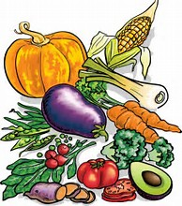
What is a garden?
A man-made landscape,
A planned space, usually outdoors, set aside for the display, cultivation, and enjoyment of plants and other forms of nature.

Slide 4
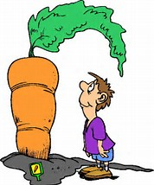
What is a garden?
It can incorporate both natural and man-made materials.
Depending on which part of the world we live in, gardens can be grown throughout the year or just during the warm months of the year.
Gardens can also be very exciting outdoor laboratories where all aspects of science seamlessly function to create a beautiful habitat!

Slide 5
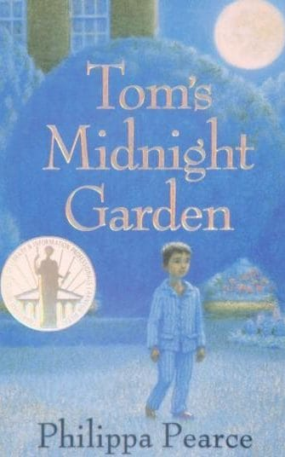
Some famous historical and literary gardens…
Garden of Eden (Biblical garden)
Hanging gardens of Mesopotamia
Botanical gardens of London
Botanic Gardens of Oxford
Garden of Versailles Castle (France)
Ryōan-ji Zen Garden (Kyoto, Japan)
Garden of Live Flowers (Alice in Wonderland)
Tom’s Midnight Garden (Novel by Philippa Pearce)
Capulet’s garden (Romeo and Juliet)

Slide 6
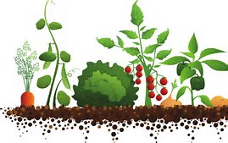
Types of gardens…
Flower gardens
Water/floating gardens
Vegetable gardens
Medicine gardens
Zen gardens
Market gardens
Rock gardens
Greenhouse gardens
Kitchen gardens
Community gardens
Cooperative gardens

Slide 7
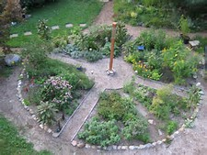
Types of Native American Gardens…
Mother Earth Medicine garden
Medicine wheel garden
Three sisters garden
Flower gardens/ prairie gardens

Slide 8
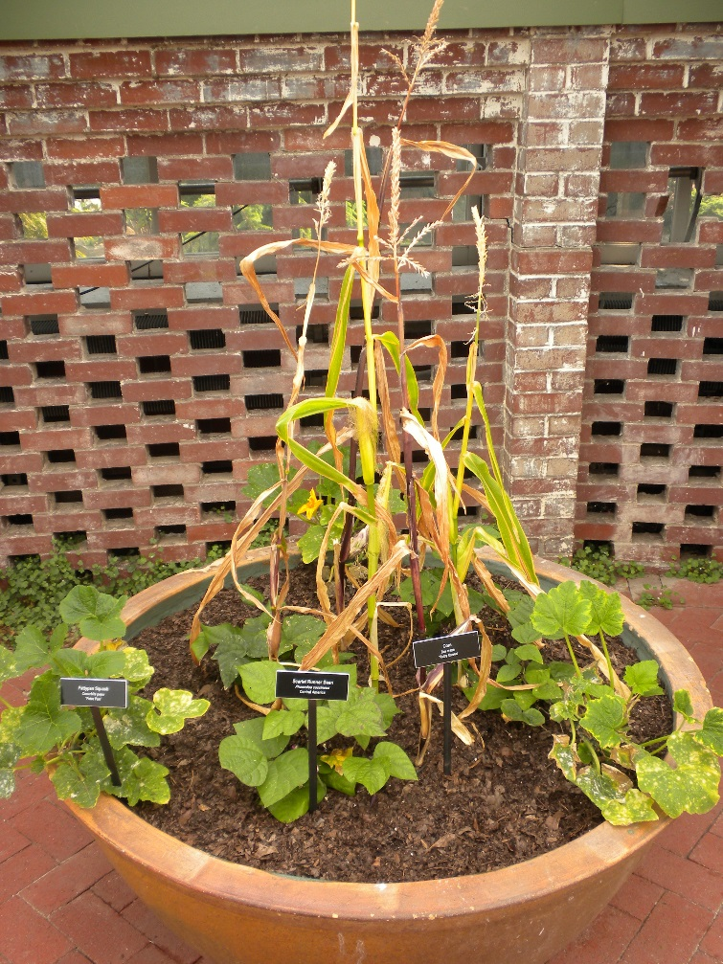
Science and art behind gardens…
Requires the knowledge of multiple disciplines
Concepts of importance include
Ecology and interaction in the environment
Soil characteristics, soil microbes and nutrients
Climatic and weather requirements
Design and landscape characteristics
Plant species and their interactions with other organisms
Pests and nuisance organisms

Slide 9
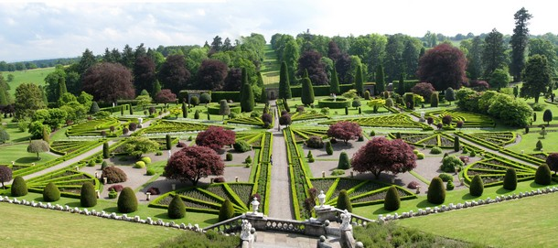
Today’s lesson
Starting a garden is a daunting but exciting endeavor
There are all kinds of decisions to make, but a little planning can go a long way.
The goal of this lesson is:
to understand the fundamental sciences behind the creation and maintenance of gardens.
to look at ecosystem dynamics of gardens and the traditional and cultural aspects of gardens.

Slide 10
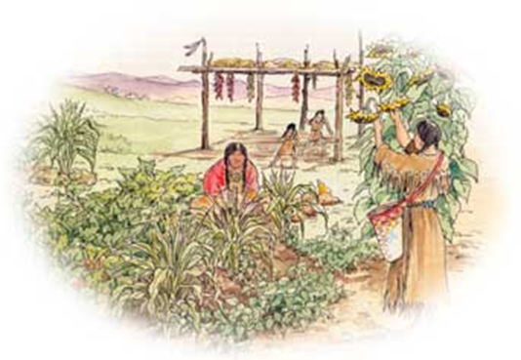
Activities for Today:
Activity 1: Stuff in your garden
Activity 2A: Soil Organisms
Activity 2B: Soil Microscopy
Activity 3: How to Start Seeds
Activity 4: Garden Planner
Activity 5: Edible Garden Soil Mosaic

