Slide 1
WIND ENERGY
Project nature summer camp 2017

Slide 2
Wind energy
Session Organization:
9:00 – 9:30 Cultural Connection and General Organization
9:30 – 10:30 Power Point part 1 (background information and
Activity 1) Activity 1:Pinwheels
10:30 – 11:30 Activity 2: Propeller Design
11:30 – 12:00 PowerPoint and Activity 3: Presenting Horizontal and
Vertical Axis Wind Turbines
12:00 – 12:45 Lunch
12:45 -1:15 Finish Activity 3
1:15 – 2:15 Activity 4: Wind Anemometer
2:15 – 2:45 Activity 5: Debating the Wind Energy Industry
2:45 -3:00 Wrap up, clean up, and closing discussion

Slide 3
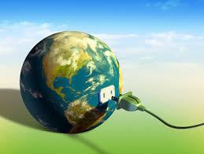
EnerGY
The society we live in uses energy - lots of it - to run the systems and services that we depend on.
Where does all this energy come from?
All our energy sources come from the natural world, so where can energy be found, and in what form?

Slide 4
Wind energy
Wind energy is one of the fastest-growing forms of electric power generation.
The search for pollution-free, sustainable energy has promoted this industry worldwide.
This nation ranks first in the world for wind electricity generation. Wind energy accounts for approximately 1% of our electricity supply.
The Department of Energy is examining the feasibility of using wind energy to generate 20% of the nation’s electricity by the year 2030.
The outlook for increasing the number of wind power plants and wind power technology around the world looks imminent.

Slide 5
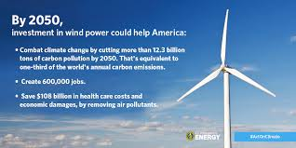
wind
Wind is caused by the uneven heating of the earth’s surface.
Wind’ energy has been used to do work throughout history from moving sailboats to generating electricity.
Today, wind is harnessed primarily to generate electricity.

Slide 6
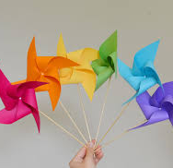
ACTIVITY 1:
PINWHEELS

Slide 7
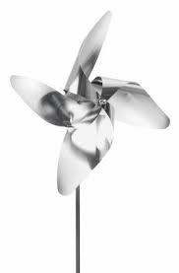
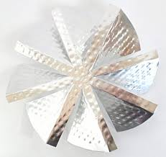
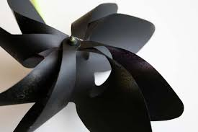
Activity 2- Propeller Design

Slide 8
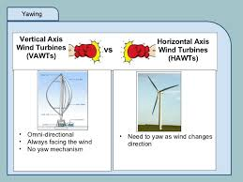
Horizontal and Vertical Axis Wind Turbines

Slide 9
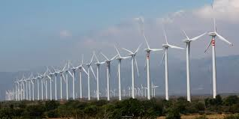
How Wind Turbines work

Slide 10
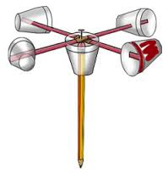
Activity 4- Wind Anemometer

Slide 11
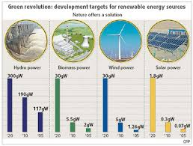
Activity 5
Debating the Wind Energy Industry

