Slide 1
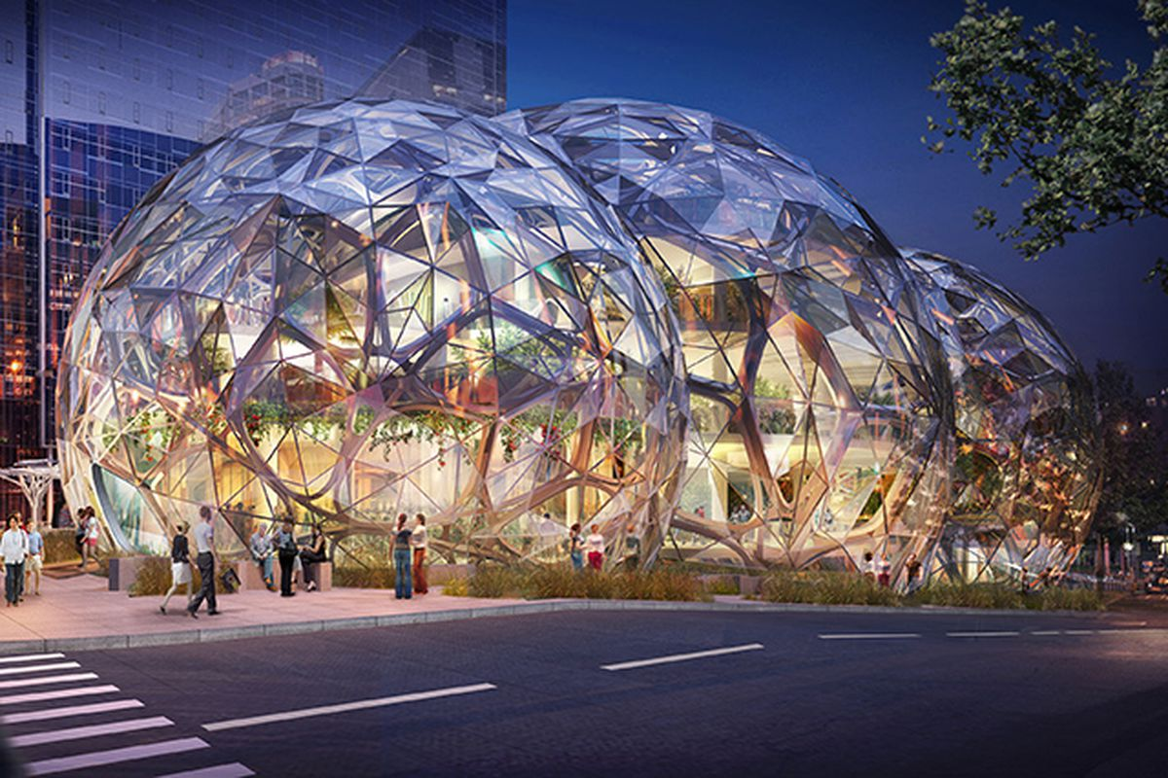
BIODOMES

Slide 2
Biodome
What is a biodome?

Slide 3
Biodome
A biodome is a closed structure that contains an environment.
Engineers create and study biodomes to better understand how things interact with each other in a specific environment.

Slide 4
Biodome
Biodomes contain both biotic (living) and abiotic (nonliving) factors, just like the biosphere, and are constructed to represent a specific ecosystem or environment. Examples of biotic and abiotic factors include plants, animals, weather and climate, air, soil, water, and sunlight.
Some examples of environments found in the biosphere include tropical rain forests, deserts, other forest types (such as deciduous or coniferous), grassland prairie and arctic climates.

Slide 5
Biodome
A biodome acts as an artificial habitat for the plants and organisms that the engineer decides to place within it.
Engineers want to determine the conditions in which a biodome environment is in equilibrium, or in a state in which all the different living and nonliving things exist in a balance, without any disappearing.

Slide 6
Benefits of Biodomes
It creates its own water, nutrients and survives without any help from the outside.
It allows you to learn the behavior of all different kinds of plants, insects and eco-systems.
You can replicate different eco-systems such as the Desert, the Arctic, the Amazon jungle and others without actually going to those places.
You are given the chance to preserve plants and animals and create an outdoor area that is self-sufficient and sustainable.
It also saves money, energy and water because of its regenerative nature.

Slide 7
Biodomes That Exist Today
Biosphere 2 Tuscon, AZ, USA
Montreal, Quebec, Canada
The Eden Project, England, UK

Slide 8
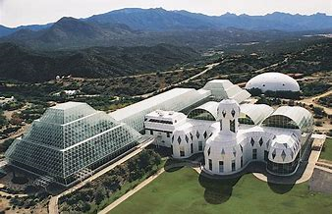
Biosphere 2 – Tucson, AZ
Scientists lived for 2 years in this three-acre utopian greenhouse called Biosphere 2.

Slide 9
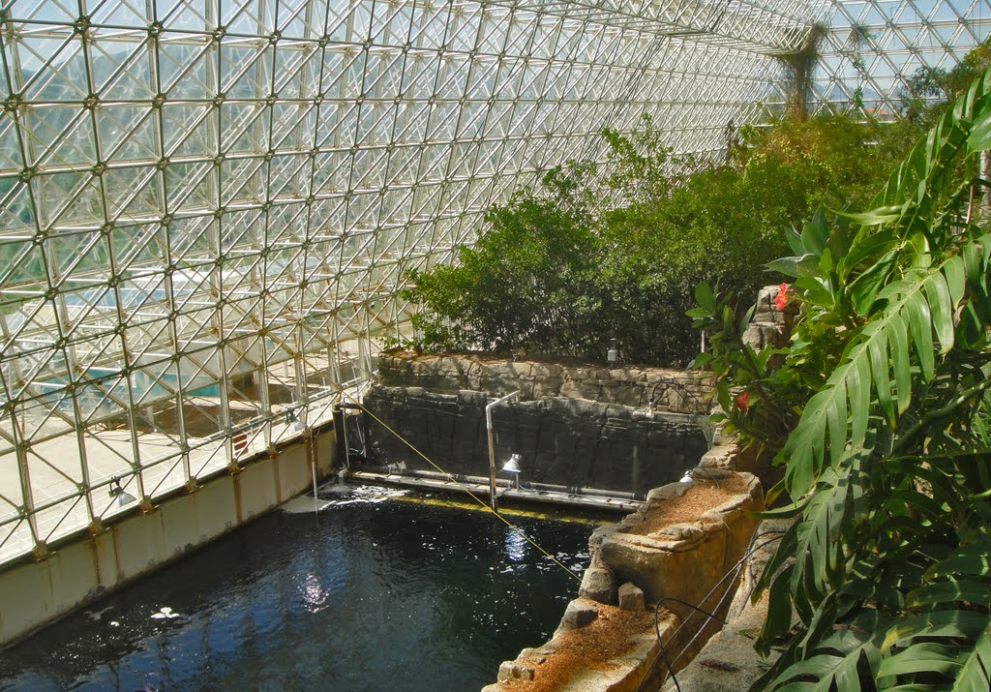
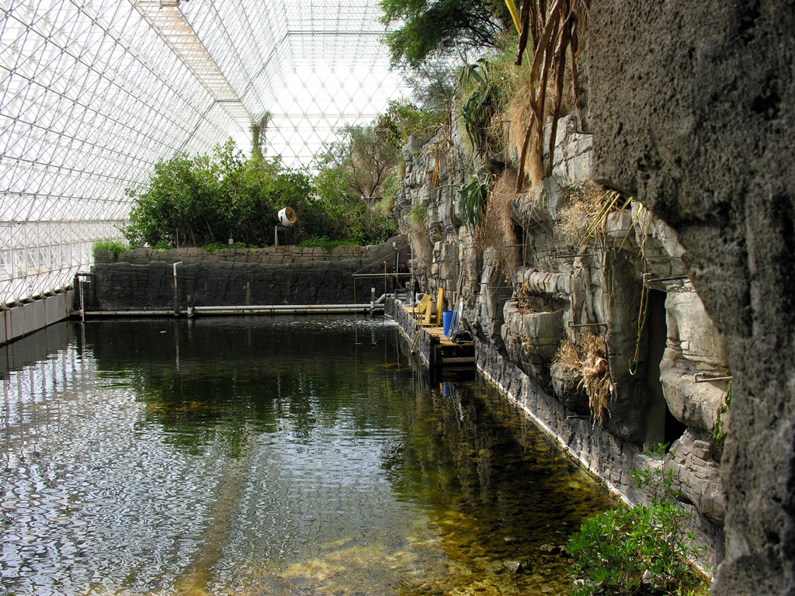
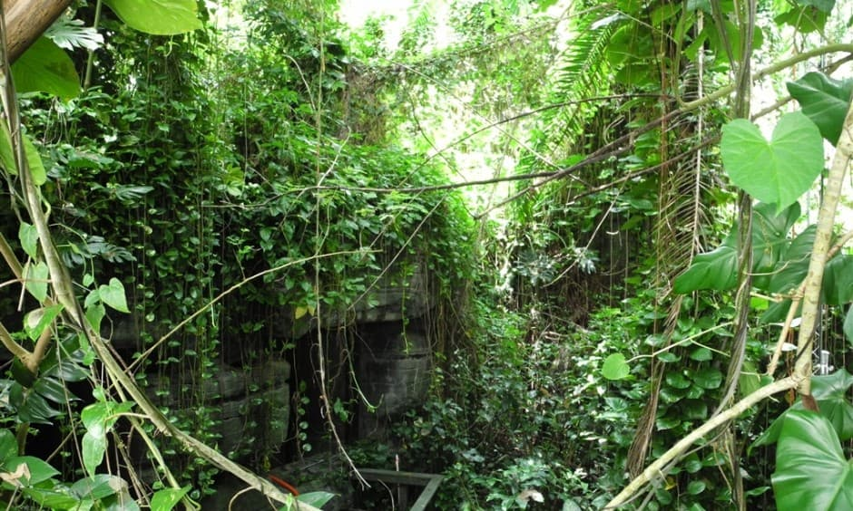
Image source: http://www.panoramio.com/photo/52262308
Image source: http://www.chrishiggins.com/blog/2008/04/tucson-az-biosp.html
Image source: http://momvoyage.hilton.com/photo/biosphere-2-tropical-rainforest/

Slide 10
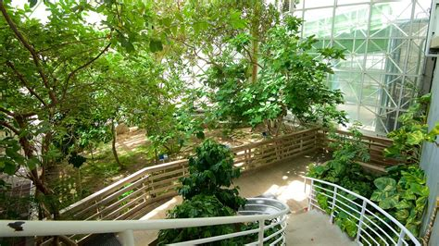
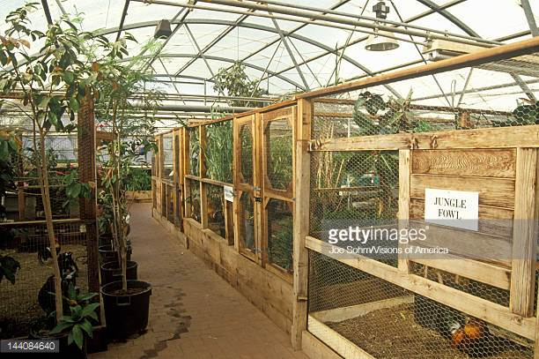
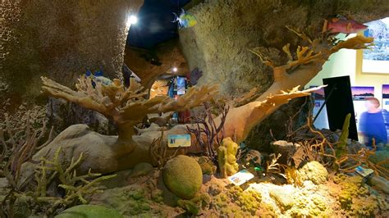
Image source: https://www.expedia.com/Biosphere-2-Tucson.d6062979.Vacation-Attraction
Image source: https://www.expedia.com/Biosphere-2-Tucson.d6062979.Vacation-Attraction
Image source: https://www.expedia.com/Biosphere-2-Tucson.d6062979.Vacation-Attraction

Slide 11
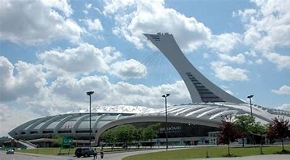
Montreal, Quebec, Canada
The Montreal Biodome is a facility located at Olympic Park in the Montreal that allows visitors to walk through replicas of four ecosystems found in the Americas.

Slide 12
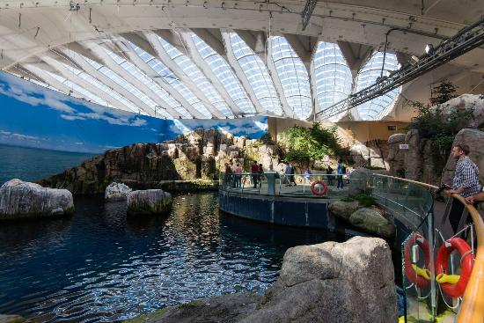
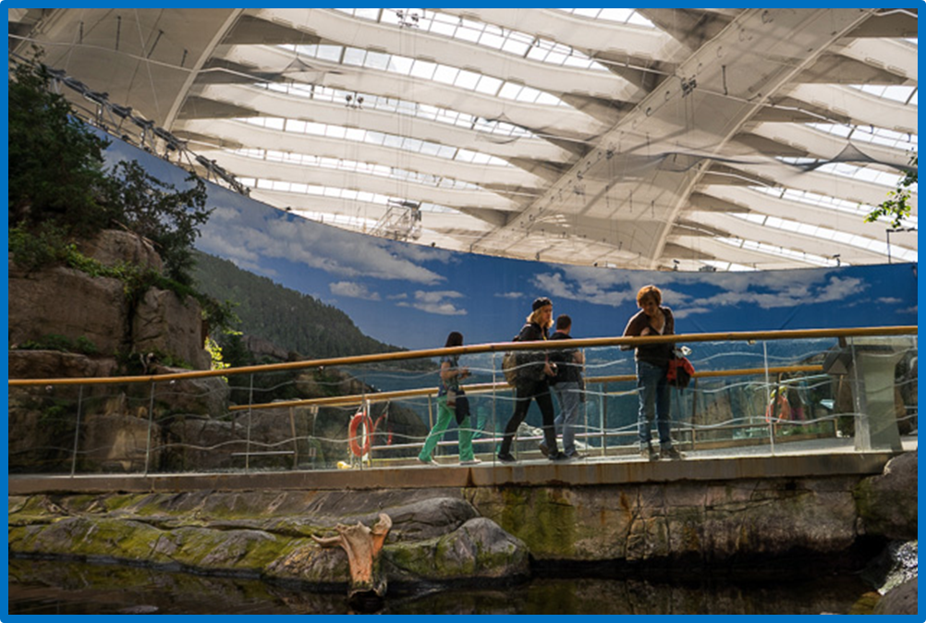
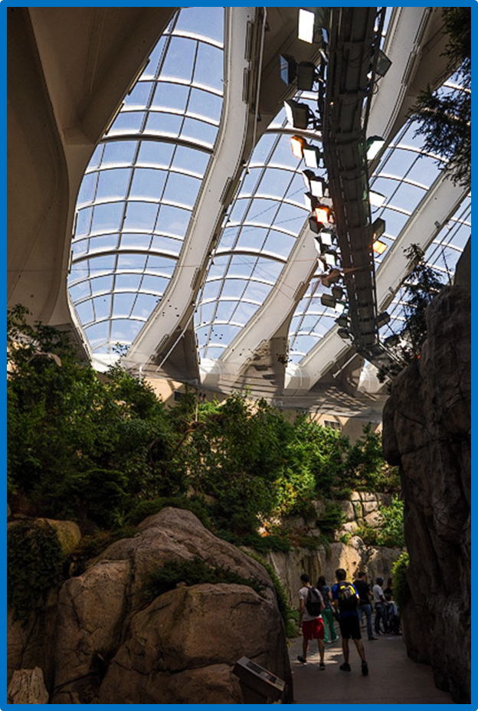
Image source: http://montreal.for91days.com/the-biodome-at-the-olympic-park/
Image source: http://www.tripadvisor.com/LocationPhotoDirectLink-g155032-d155333-i152050647-Biodome_de_Montreal-Montreal_Quebec.html
Image source: http://montreal.for91days.com/the-biodome-at-the-olympic-park/

Slide 13
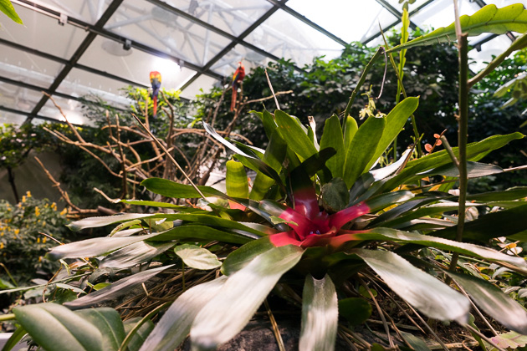
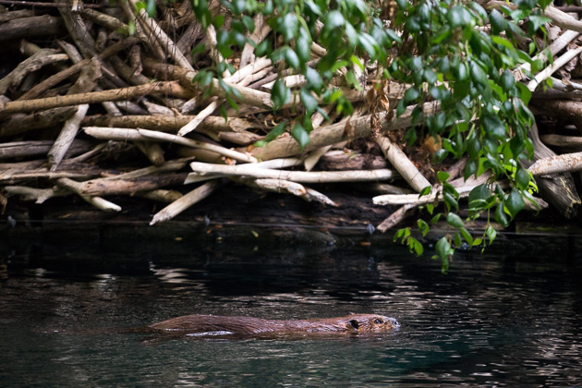
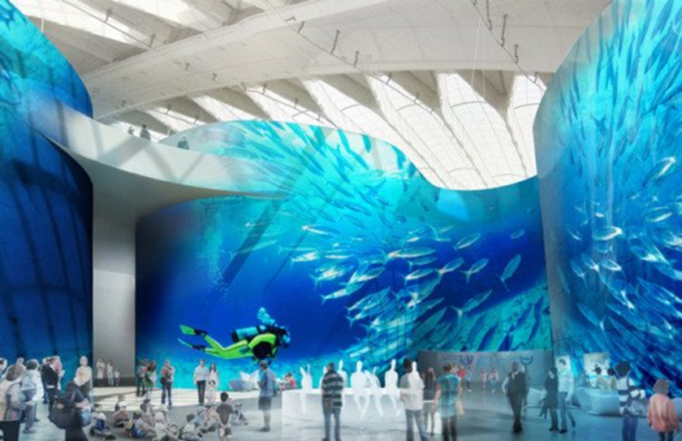
Image source: http://montreal.for91days.com/the-biodome-at-the-olympic-park/
Image source: https://inhabitat.com/massive-biodome-upgrade-unveiled-for-montreals-1979-olympic-park/
Image source: http://montreal.for91days.com/the-biodome-at-the-olympic-park/

Slide 14
The Eden Project – Cornwell, England
The Eden Project is a popular visitor attraction. Inside the two biomes are plants that are collected from many diverse climates and environments.

Slide 15
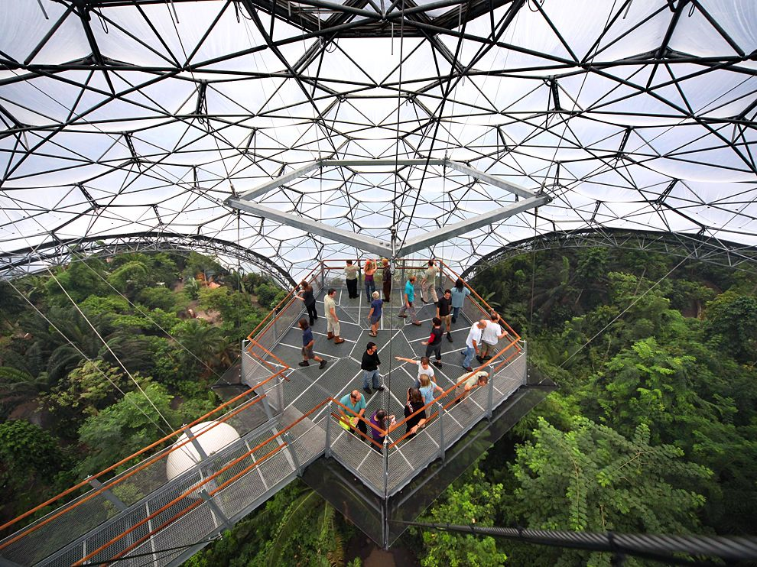
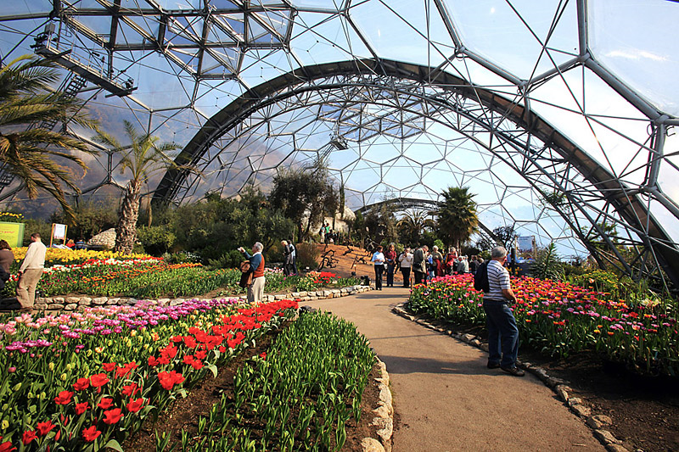
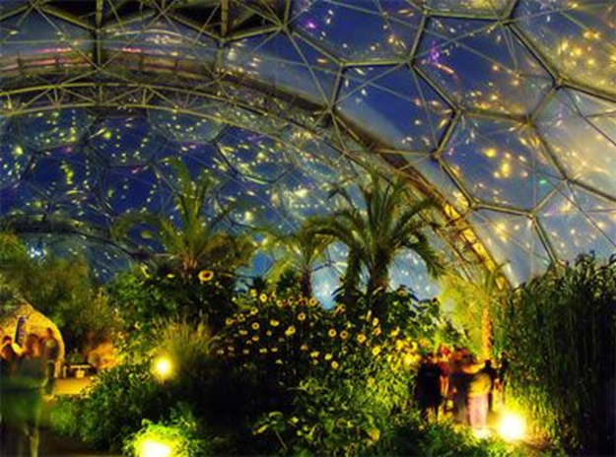
Image source: http://www.quiet-corner.com/garden-ideas/big-gardens/10-amazing-indoor-gardens/
Image source: http://pinterest.com/pin/108860515963096261/

Slide 16
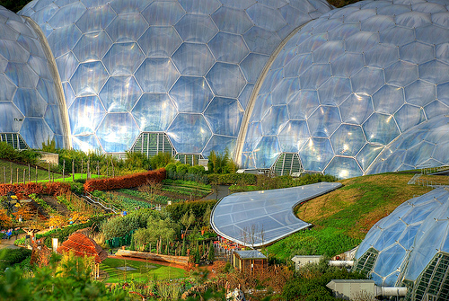
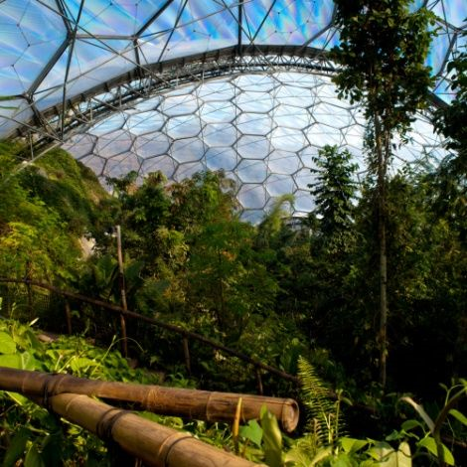
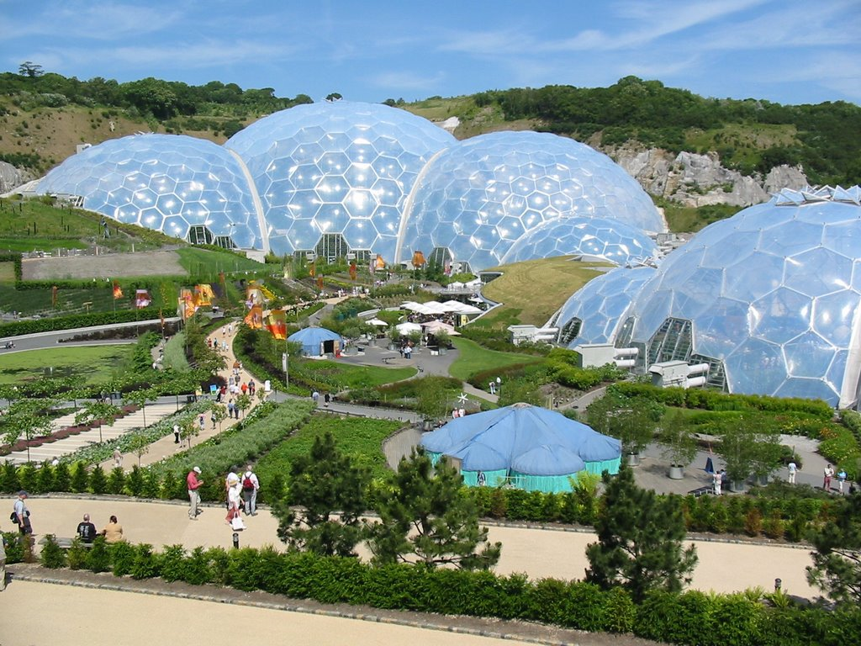
Image source: https://www.pinterest.com/jesikahsundin/the-biodome-chronicles-book-series/
Image source: http://blog.stuartherbert.com/photography/2008/04/03/winter-in-eden/
Image source: http://raredelights.com/unusual-buildings-across-world/

Slide 17
Virtual Biodomes
Videogames:
Minecraft
Roblox
Movies:
The Matrix
Biodome
The Martian - https://www.youtube.com/watch?v=FbH4NM5nCCA

Slide 18
How can we, as Nature Camp students, create a biodome to sustain life on Mars?
Need to knows for creating a biodome:
What is an ecosystem?
What is the population density (equilibrium)?
How do we create a constant source of energy (food chain/web)?

Slide 19
Environments and Ecosystems
An environment is the surrounding area in which an organism lives, including the air, water, food and energy required for that organism to survive.
An ecosystem includes all the living organisms and the nonliving things in an area that are linked together through the flow of nutrients and energy.

Slide 20
Activity 1
Environments and Ecosystems Research

Slide 21
Population Density
The amount of organisms in a particular environment is called its population. Populations are made up of all the members of a species living in the same place at the same time sharing space and resources.
Population density is the population per unit of land area; for example, persons per square kilometer of land. Population density helps us describe how much space an organism has in that unit of land, which helps us understand how the resources (water, food, etc.) might be divided.

Slide 22
Population Density
Let's consider a biodome of a tropical environment about the size of a shoebox. Could you put a population of 10 medium-sized insects in it? 10,000? What is the number of insects that you think could comfortably survive within it? What might happen if you have too many insects?
Now, let's think about our own classroom — a room that we share with each other and the teacher. What is the population of our class? How much space does each person have in our classroom? What might happen if we try to fit the entire school into our classroom? Today we are doing an activity to find out the population density and exactly how much space each person has in our classroom right now.

Slide 23
Activity 2
Population Density

Slide 24
Food Chains
A food chain is a series of nutrients and energy moving through a chain of organisms.
All food chains start with the sun which provides energy to producers (organisms that are capable of making their own food, such as plants) that use photosynthesis to grow and become food for consumers (herbivore or carnivore) like us (any organism that gets its food by eating producers or other organisms Decomposers (such as bacteria, molds, mushrooms and mildew) break down discarded plant and animal (organic) materials into simpler substances which returns nutrients to the soil and atmosphere for new plants to use to grow.

Slide 25
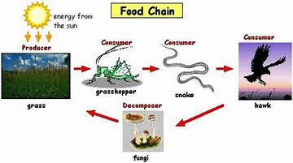

Slide 26
Example of Food Chains:

Slide 27
Food Web
A food web is a type of food chain that happens when one organism gets energy from more than one source, such as people eating vegetables, chicken and milk for one meal.
Food chains are often drawn with arrows that point in one direction, for example, from the sun to a plant. The arrows show us the direction that energy is moving through a food chain. Food webs are more complicated; they have arrows that go all over the place, from animals to both plants and other animals.

Slide 28
Example of a Food Web

Slide 29
Activity 3
Food Chains and Webs

Slide 30
Activity 4
Create Your Own Biodome

Slide 31
References
Bush, Mark B. Ecology of a Changing Planet. Second Edition. Saddle River, NJ: Prentice Hall, 2000.
© 2004 by Regents of the University of Colorado.

