Slide 1
Science and Tradition of Meat Safety and Preservation.
Deland Myers Sr. and Clifford Hall (NDSU)
Mafany Mongoh (Sitting Bull College)
Charles Morin (Four Winds Community School)

Slide 2
The Schedule
11:00-11:30 General organization/Cultural connection
11:30-12:00 Background about preservation methods and jerky/dried meat production
12:00-1:00 Activity 1 – Preparation of jerky, place in dehydrator
1:00-1:30 Lunch
1:30-2:00 Activity 2 – Impact of salt on meat preservation
2:00-2:30 Activity 3 – Sensory Evaluation of dried meats
2:30-3:00 Wrap-up and Evaluation

Slide 3
Summary
The project will focus on meat products similar to beef jerky, which is the counterpart to traditional Native American dry meats.
The Sunday Academy will be divided into 4 parts.
Traditional meat preservation methods.
Role of Ingredient and drying as preservation methods. Preparation of jerky from beef, bison, deer, and elk.
Evaluation of samples with different levels of salt in jerky formulas.
Sensory testing of jerky (to be done outside of the lab).

Slide 4
Cultural Activity
Traditional Native American Meat Preservation
Meat Preservation from other cultures (e.g., Africa)
http://www.fao.org/docrep/003/x6932e/X6932E02.htm

Slide 5
Meat Preservation from other cultures
These developed techniques and procedures usually try to:
Make the meat last longer
Prevent spoilage, decay and microbial growth
Have good flavor and taste better
Have nice visually appealing color and structure
Have an appealing odor or aroma

Slide 6
Meat Preservation from other cultures
Most cultures have developed techniques and procedures for preserving meats that have been handed down for hundreds of years
These techniques can typically be divided into:
Drying
Curing
Smoking
The use of spices, herbs, and additives
Or a combination of any two techniques

Slide 7
Meat preservation from other cultures
We are going to describe examples of dried meat or dried and further processed meat manufactured from several cultures from:
Africa,
Americas
The Near East

Slide 8
Meat preservation from other cultures
Odka (Somalia and other East African countries)
A sun-dried meat product made of dry-salted lean beef
It is often prepared from drought-stricken livestock.
Qwanta (Ethiopia and other East African countries)
Made from lean muscles of beef which are air-dried and lightly smoked
Prior to drying, the strips are coated with a sauce containing a mixture of salt (25 percent), hot pepper/chili (50 percent) and aromatic seasoning substances (25 percent).
Kilishi (Nigeria and other arid or semi-arid zones of West Africa)
Made from sliced lean muscles of beef, goat meat or lamb
produced by sun-drying thin slices of meat. It can be produced industrially using tray-drying in a warm air oven
Some roasting is also done to add flavor

Slide 9
Meat preservation from other cultures
Biltong (Southern African countries)
A salted, dried meat prepared from beef or antelope meat. All muscles in the carcass may be used to make it
But the finest biltong with the best flavor is made from the sirloin strip and the most tender is derived from the fillet
Salt and pepper are the principal ingredients used. Other ingredients such as sugar, coriander, aniseed, garlic or other spices are used to improve flavor.
Pastirma (Turkey, Egypt, Armenia)
It is salted and dried beef from not too young animals. In some areas camel meat is also used.
The meat is taken from the hindquarters and is cut into 50 to 60 cm long strips with a diameter of not more than 5 cm.
The strips are rubbed and covered with salt and nitrate.

Slide 10
Meat preservation from other cultures
Charque (Brazil and other South American countries)
It consists of flat pieces of beef preserved by salting and drying.
The pieces are submerged in a saturated salt solution for about one hour in barrels or cement vats.
Soya (Cameroon and other West African countries)
It consists of cube pieces of beef preserved by spices, roasting, and light drying on a stick or on papyrus paper.
The pieces are submerged in a mixture of salt, garlic, pepper, and other spices for about one hour in barrels or deep containers.

Slide 11
Modern Meat Preservation
U.S. Government definition of Jerky:
A meat product (Ready-to-eat*) that can be whole or meat strips or ground and molded into a shape and dried (USDA, 2004).
Moisture-to-protein ratio of 0.75 (or less) to 1 (Food Safety Inspection Service or FSIS, 2011)
Final product water activity (a_{w}) of ≤0.85 (FSIS 2012)
Internal meat temperatures of 71.1°C (160°F) must also be achieved during processing

Slide 12
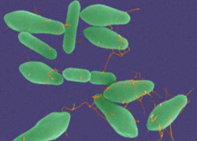
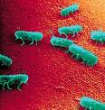
Modern Meat Preservation
Definition:
Preservation: any unit operation or step that reduces or prevents the deterioration of a food
Food Safety: elimination of any hazard that can cause an illness if a food is consumed
Deterioration and safety issues can be caused by:
biological
microorganisms (bacteria, mold, etc.)
enzymes
Chemical
allergens and toxins

Slide 13
Modern Meat Preservation
Methods use by food manufacturers to preserve food or to insure safety include :
Temperature
Osmotic Inhibition: drying
***The basis for jerky production***
Chemicals: curing, smoking, spices, herbs, and additives
Irradiation
Fermentation, etc.
Hurdle effect (multiple methods)

Slide 14
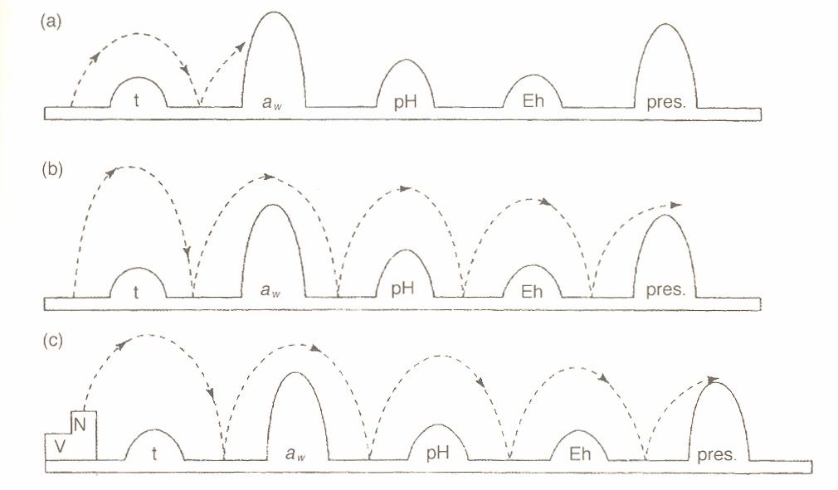
Modern Meat Preservation
Hurdle effect (technology)

Slide 15
Modern Meat Preservation
Hurdle effect for jerky products
Water activity (a_{w}) of ≤0.85
Internal meat temperatures of 71.1°C (160°F)
Addition of chemical preservatives
Salt
Sodium nitrite
Citric acid
Vacuum Packaging
Storage in freezer/refrigerator (temperature hurdle)
Storage under dry conditions

Slide 16
Modern Meat Preservation
Homemade jerky production video
http://www.youtube.com/watch?v=wp9To4L3s7A
1 1/2 to 2 pounds flank steak
2/3 cup Worcestershire sauce
2/3 cup soy sauce
1 tablespoon honey
2 teaspoons freshly ground black pepper
2 teaspoons onion powder
1 teaspoon liquid smoke
1 teaspoon red pepper flakes

Slide 17
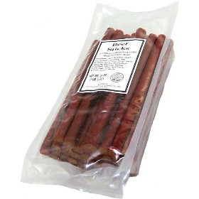
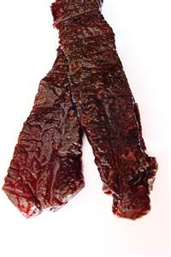
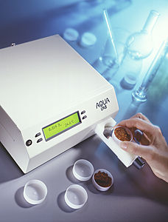
Activity 1. Preparation of Jerkies
Discussion regarding ingredients , drying, etc. preserve foods.
http://www.foodnetwork.com/altons-beef-jerky/video/index.html
The hands-on activity will involve preparing jerky.
Beef, bison, deer, and elk
Collect samples at intervals to
monitor the changes in water activity
and color
Focus is on drying time as it relates to water activity
and food safety of the product .
Plot water activity over time
Determine if meat and ingredients impacted water activity
and color

Slide 18
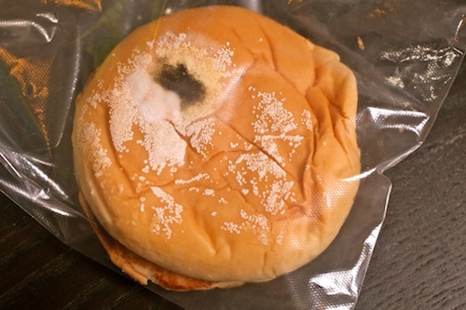
Activity 2. Evaluate the impact of seasoning/salt on meat preservation
Samples will be prepared at NDSU with varying season/salt levels and drying times. We will focus only on beef jerky in this activity.
Hands-on Activity
taste testing of samples (outside of the lab)
measuring water activity and color
observing samples for mold growth
Outcome
Understand the impact of partial drying and ingredients on the jerky quality and safety

Slide 19
Just About Right Test: Jerky Evaluation
Sample Code ___________________ Date __________________
Please taste the jerky sample provided in cups. Make a check mark in the box that indicates how you feel about the product. You are free to check any of the boxes. Each sample will be evaluated on a separate sheet and there are a total of six (6) samples. Comments are welcome.
Color:
□ □ □ □ □ □ □
Too Brown Just About Right Too Red/Pink
Texture:
□ □ □ □ □ □ □
Too Soft Just About Right Too Tough

Slide 20
Activity 3. Sensory Evaluation of Dried Meats
Samples will be prepared at NDSU with different meats used in activity 1. One formula will be used in the preparation.
Hands-on Activity
taste testing of samples (outside of the lab)
we will have a discussion about how students rated the sample and we will reveal the meat source (samples from the reservations)
measuring water activity and color (? – if time permits)
Outcome
Understand the influence of meat source on the jerky quality

Slide 21
Sensory Evaluation of Beef Jerky
SAMPLE NUMBER: _________________________
Please evaluate the bread sample for the following qualities: Flavor, Texture, Appearance and Overall Acceptability (i.e. liking). Make an X on the appropriate line. Please give comments in the space provided below each quality if desired.
APPEARANCE: FLAVOR:
----------- like extremely ----------- like extremely
----------- like very much ----------- like very much
----------- like moderately ----------- like moderately
----------- like slightly ----------- like slightly
----------- neither like nor dislike ----------- neither like nor dislike
----------- dislike slightly ----------- dislike slightly
----------- dislike moderately ----------- dislike moderately
----------- dislike very much ----------- dislike very much
----------- dislike extremely ----------- dislike extremely
COMMENTS: COMMENTS:

Slide 22
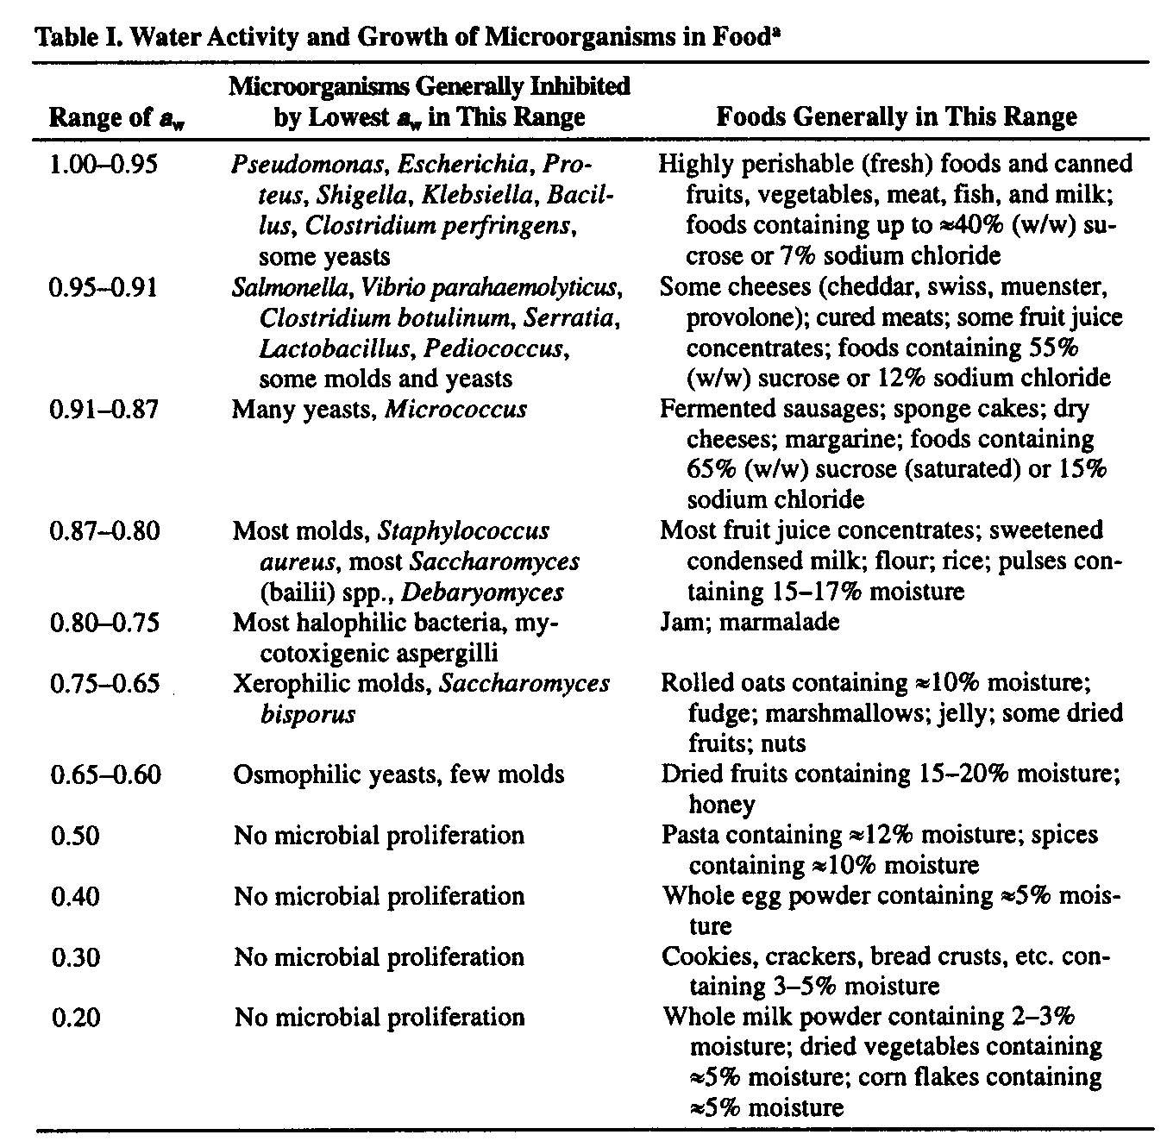
Analytical Methods
Water Activity
video

Slide 23
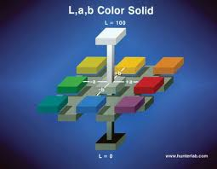
Analytical Methods
Color
Video

