Slide 1
Variability and Its Impact
Sunday Academy

Slide 2
Randomness
The word randomness is used to express uncertainty or lack of predictability
There is randomness in every activity or event of the nature
A random process is a repeating process whose outcome is going to be different every time you repeat it

Slide 3
Randomness (Examples)
Following examples represent random processes showing randomness (uncertainty) in outcome:
  Die tossing experiment
    There are six possible outcomes
  Coin tossing experiment (tossing one coin or two coins)
    In one coin tossing experiments—two possible outcomes
    In two coin tossing experiment—four possible outcome
  100 meter race
    Infinite number of outcomes
  Manufacturing process
    Infinite number outcomes

Slide 4
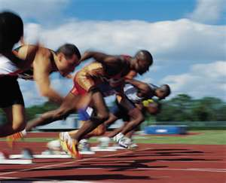
Variability in Data
The randomness in the process introduces variability in output
Variability in process output can be visualized by plotting output data
Consider an example of 100 meter race (50 data points)

Slide 5
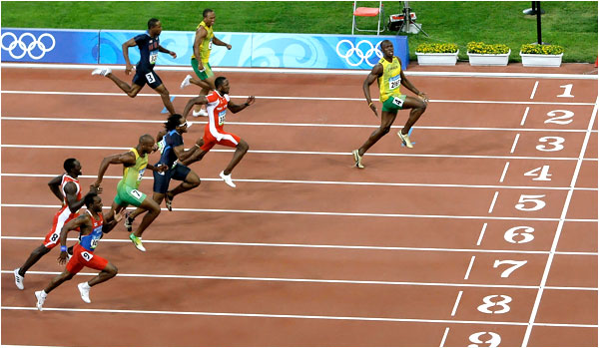
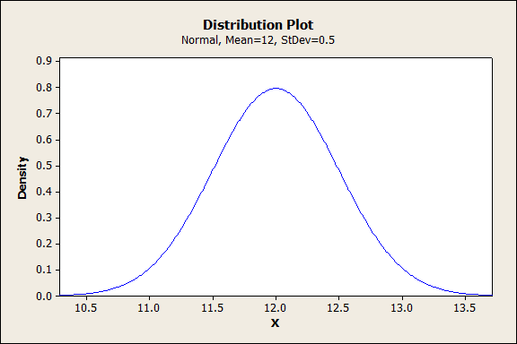
Distribution of 100 Meter Race Data

Slide 6
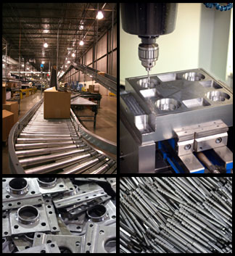
Variability in Data
Consider the example of manufacturing process A
  Process mean 20 mm and standard deviation is 1.5
20.31283 | 19.39501 | 19.45106 | 20.29773 | 19.56457
21.71206 | 22.24744 | 21.97172 | 19.01167 | 19.31147
19.99444 | 20.14174 | 19.00415 | 20.14216 | 17.85418
17.68678 | 17.78977 | 17.57981 | 20.03864 | 21.23031
20.08266 | 21.1749 | 21.75335 | 17.01412 | 20.51639
23.07748 | 20.17881 | 19.39453 | 22.56767 | 19.2325
18.08875 | 20.17125 | 19.66035 | 18.47756 | 22.35663
20.35358 | 21.59685 | 18.60307 | 22.37291 | 21.18782
21.17005 | 21.15641 | 20.5086 | 21.33769 | 22.39374
18.77972 | 21.44364 | 21.42701 | 18.14275 | 20.10102
19.65607 | 18.43716 | 22.39732 | 20.54415 | 18.91548
18.41701 | 19.77752 | 20.13256 | 20.05614 | 20.65762
20.07871 | 19.70502 | 21.70513 | 20.6592 | 19.8837
21.19967 | 17.55707 | 20.47762 | 20.07277 | 20.35808
19.81505 | 19.96561 | 21.28724 | 20.38178 | 18.71393
19.46477 | 22.72691 | 19.75854 | 18.75741 | 19.92768
21.13898 | 19.91633 | 20.2415 | 18.82761 | 17.42401
20.73688 | 15.97425 | 22.67455 | 18.26199 | 19.71511
19.57007 | 21.14534 | 18.3614 | 21.4372 | 23.17713
19.40244 | 18.33874 | 18.74523 | 19.34256 | 20.62399

Slide 7
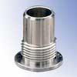
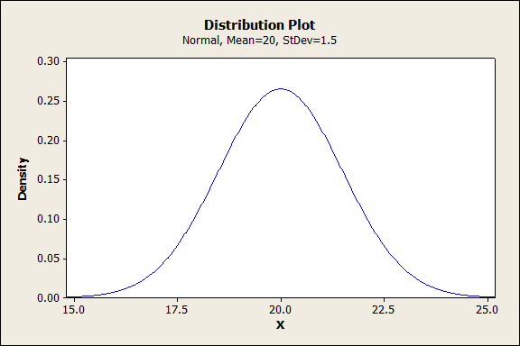
Distribution of Manufacturing Process Output

Slide 8
Distribution Parameters
To measure the central tendency:
  Mean, Median, and Mode
To measure the total spread of the data:
  Range and Standard Deviation (Std. Dev.)

Slide 9
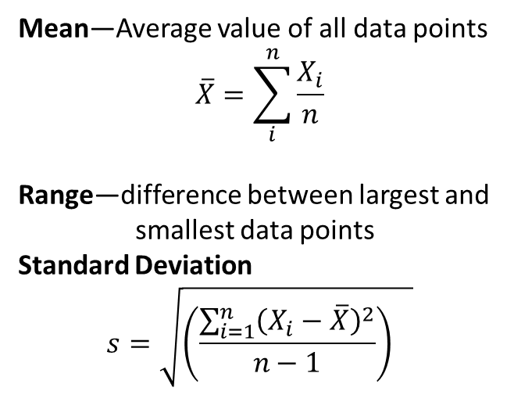
Symmetric Distribution
Considering n number of data points:
X1, X2, X3, … , Xn
Mean—Average value of all data points
$$\overline{X}=\sum_{i}^{n}{\frac{X_{i}}{n}}$$
Range—difference between largest and
smallest data points
Standard Deviation
$$s=\sqrt{{\left(\frac{\sum_{i=1}^{n}{{\left(X_{i}−\overline{X}\right)}^{2}}}{n−1}\right)}^{}}$$
For symmetric distribution mean, median, and mode will have the same value

Slide 10
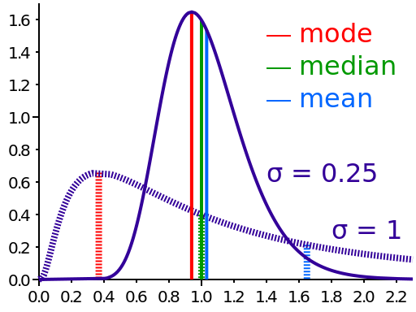
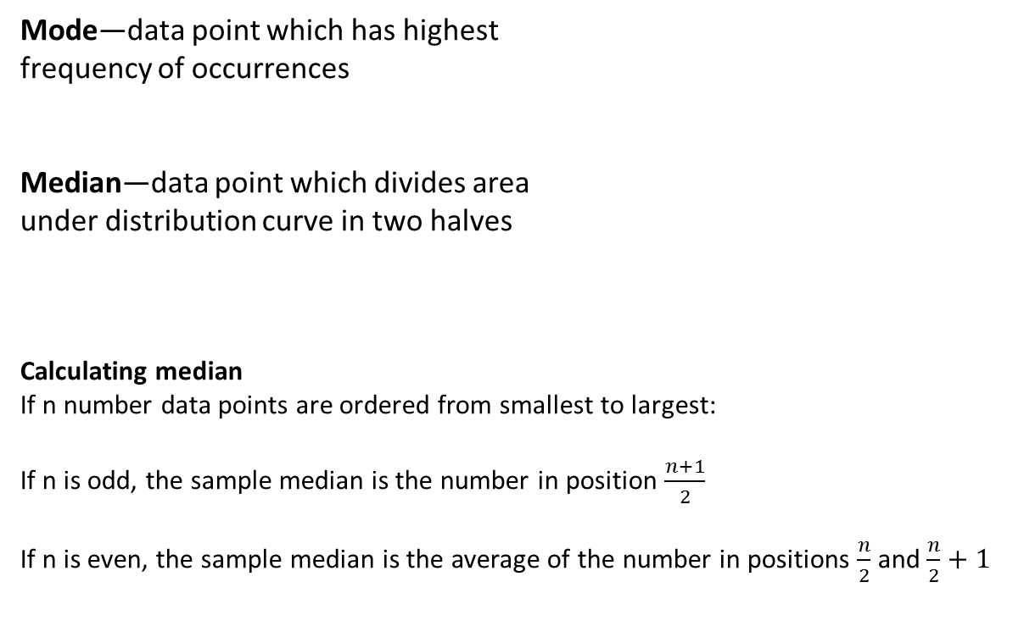
Asymmetric Distribution
Mode—data point which has highest
frequency of occurrences
Median—data point which divides area
under distribution curve in two halves
Calculating median
If n number data points are ordered from smallest to largest:
If n is odd, the sample median is the number in position $\frac{n+1}{2}$
If n is even, the sample median is the average of the number in positions $\frac{n}{2}$ and $\frac{n}{2}+1$

Slide 11
Calculation Example
Given the data set
{13, 3, 10, 9, 7, 10, 12, 8, 6, 3, 9, 6, 11, 5, 9, 13, 8, 7, 7}
find the mean, median and mode.
Rearrange data set from smallest to largest
Mean
Median
Mode

Slide 12
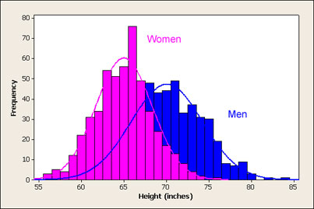
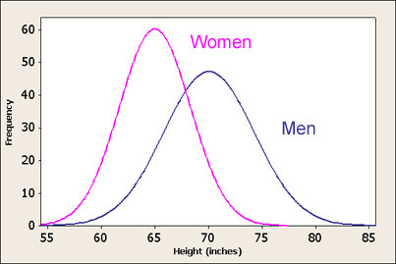
Another example
The population of Fargo city: adult male heights are on average 70 inches (5'10) with a standard deviation of 4 inches. Adult women are on average a bit shorter and less variable in height with a mean height of 65 inches (5'5) and standard deviation of 3.5 inches. If we took a large sample of men and women's heights and graphed the frequency of the heights we'd see something like the following:

Slide 13
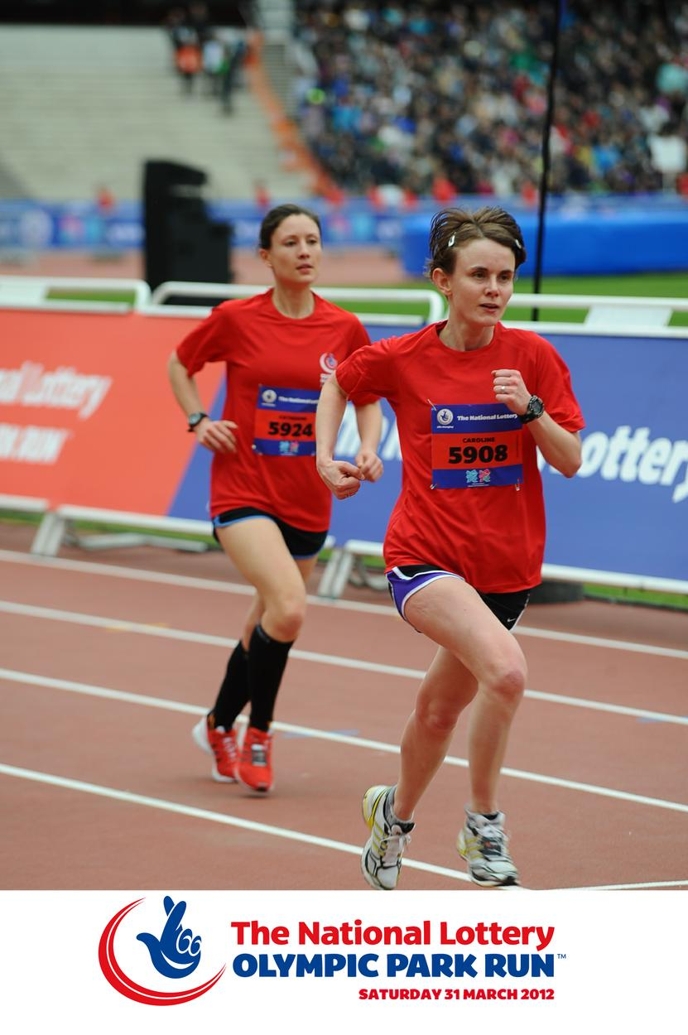
Performance Comparison (Impact of Variability)
Two Players A and B competing for the 100 meter Olympic race.
Their performance during practice sessions is shown below (30 recorded practice timing)
Both players are giving average run time of 12 seconds with different variability (Std Dev).
For player A standard deviation is (0.5) and for player B Std. Dev. Is (0.25)

Slide 14
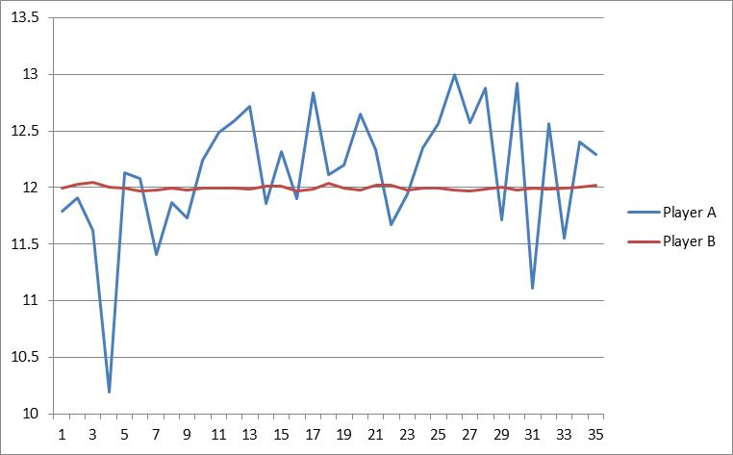
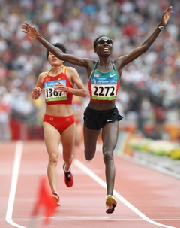
Performance Comparison (Impact of Variability)
If you want to bet on any of these two players, who would be your choice and why? A or B

Slide 15
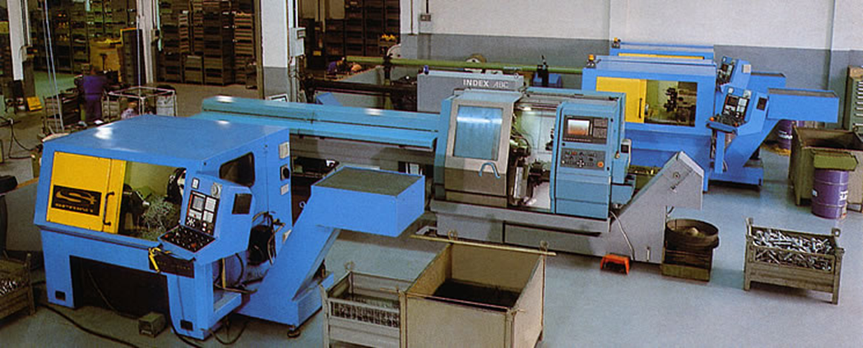
Impact of Variability on Product Quality
Two different production processes
Process A performance : Mean 20, Std Dev 1.5
Process B performance: Mean 20, Std Dev 0.5
Which process is more effective to produce good quality products?

Slide 16
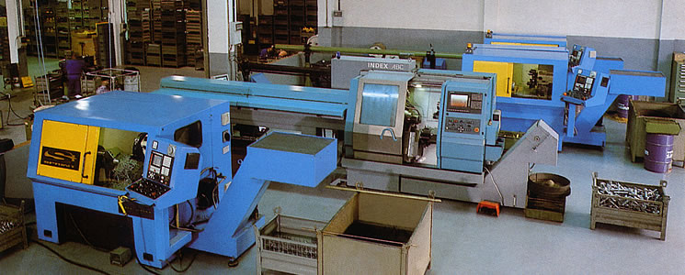
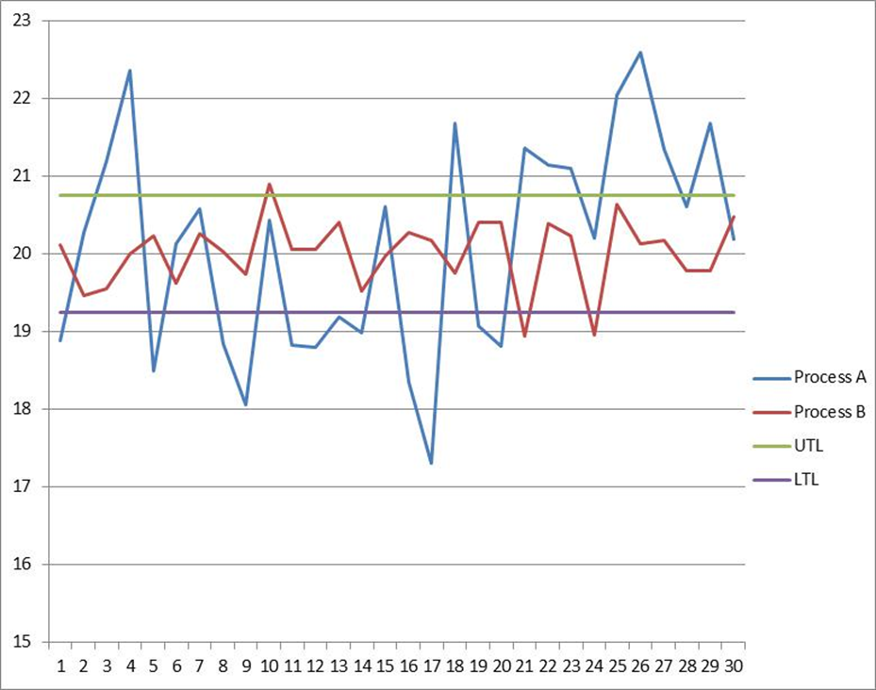
Impact of Variability on Product Quality
Which process produces better quality product? A or B

Slide 17
Impact of Variability on Business Performance
How a defective item affects business performance—chain reaction

Slide 18
Activities
Three activities to demonstrate the concepts
  Die tossing experiment to explain random processes
  Sampling experiment to show random inspection process to find defective items and making decision on samples to accept or reject
  Helicopter design experiment to build quality into design

Slide 19
Activity 1: Die Tossing Experiment
To demonstrate random process concept
  Toss a die and observe up face
  Record the outcome in the table (mark each outcome as star in appropriate column of the table)
  Repeat the exercise 50 times and record the outcome
  Compare the distribution on outcomes of each group
  Combined the outcome from each group and observe the distribution

Slide 20
Activity 1: Die Tossing Experiment

Slide 21
Activity 2: Sampling experiment
Demonstrating quality inspection process
  Decide the decision rule (more than 5 % defective will result in rejecting the lot)
  Select the appropriate lot size (25, 50 or 100)
  Determine the sample size (say 10% of the of the lot size)
  Use appropriate bowl paddle to get lot
  Randomly pick a row from paddle for considering as a sample (say row 4),
  Count the number of bad parts (colored beads)
  Make decision on the lot

Slide 22
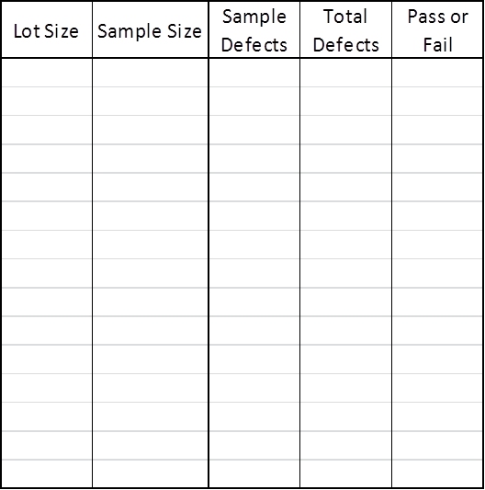
Activity 2: Sampling experiment
Table to sampling data collection

Slide 23
Activity 3: Helicopter Design

Slide 24
Activity 3: Helicopter Design

Slide 25
Activity 3: Helicopter Design

Slide 26
Activity 3: Helicopter Design

Slide 27
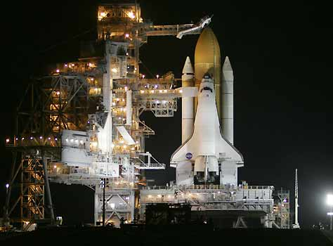
Just imagine the impact of variability here
Questions and Discussion

