Slide 1
Candyland Ecology
NATURE 2014-2015

Slide 2
Ecology Terms
Ecology
Scientific study of interactions among organisms and their environment
Optimal Foraging Theory
Animals behave in a way to have the most caloric intake with the least amount of time and energy expended
Tragedy of the Commons
Animals behave in their own self interest even though it is harmful to the whole group’s long term interests

Slide 3
Ecology Terms (Continued)
Niche- position taken by an organism within its community
Competition
Asymmetrical- effects on organisms are different
Symmetrical- effects on organisms are the same

Slide 4
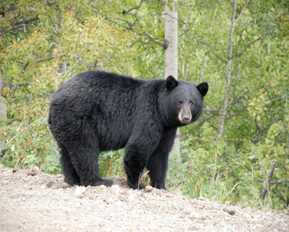
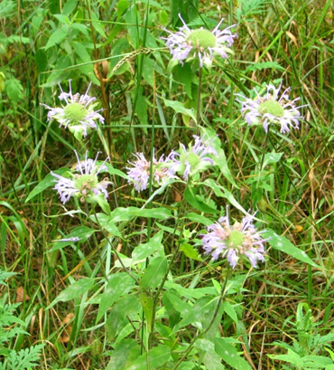
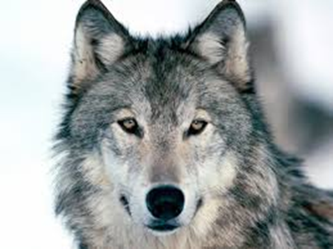
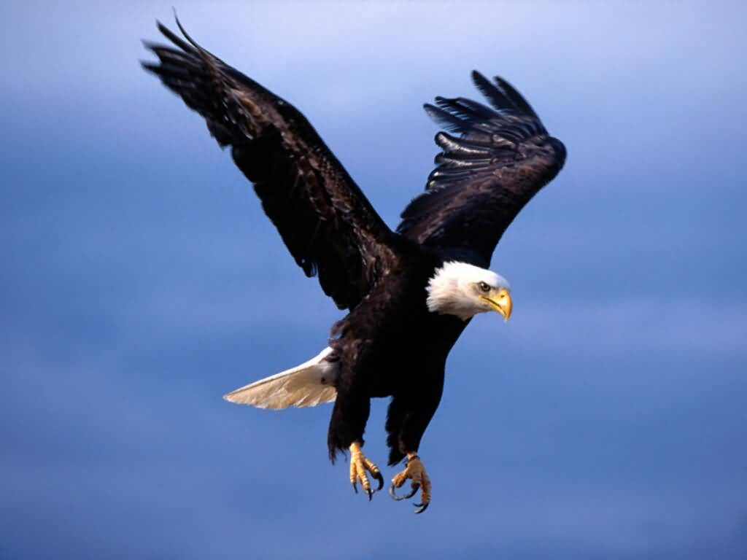
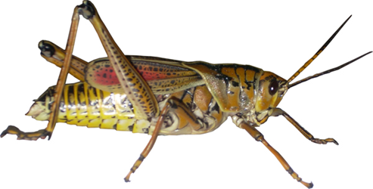
Introduction

Slide 5
Questions???
What does each organism on the last slide need to be able to survive?
What does each organism on the last slide interact with?

Slide 6
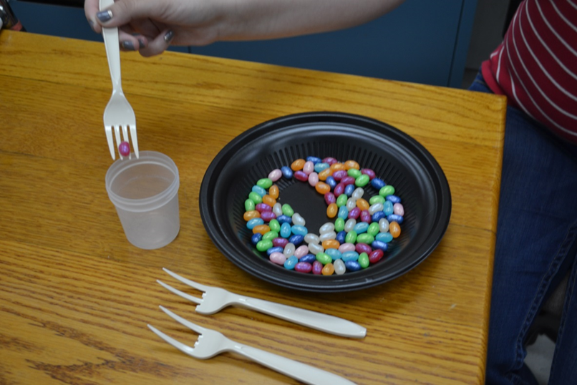
Get Started!!

