Slide 1
Communication Signals and Radio Receiver
2014 NATURE Sunday Academy
Rotating Lesson Plan

Slide 2
Project Description

Slide 3
Session Timeline

Slide 4
The History of Radio Youtube Link: http://www.youtube.com/watch?v=Y-A9wrL88nM

Slide 5
The Task
In the 1800’s, communication over wires had been established.
Europe, French, British, Germans all had patents on various telegraphy designs, by such people as Charles Wheatstone. They were, however, complicated and unreliable.
An American Republic prize existed for an efficient communications system that covered the Atlantic Coast. Prior communications were done by optical signaling, which had distance and weather conditions issues.

Slide 6
Demonstration: Morse Code recollect our last year??

Slide 7
Career: Communication Scientists, Wireless Engineers
Modern communication systems intersects the disciplines of mathematics, computer science, and electrical engineering. Applications of communications systems are used in Radio, TV, Traffic Signals.

Slide 8
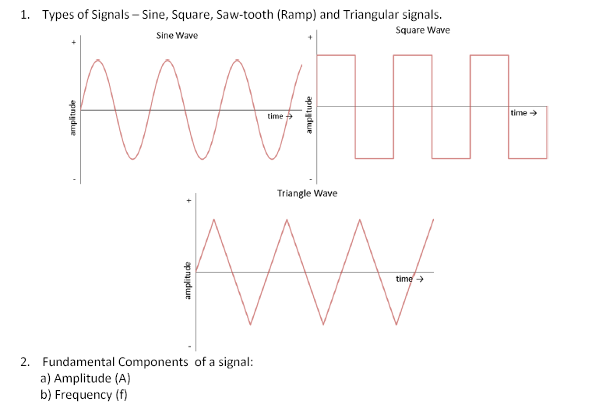
Signals and Types

Slide 9
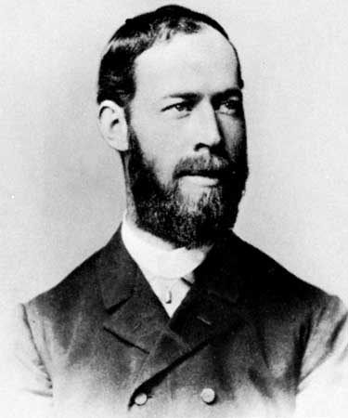
Frequency
Identified Electromagnetic waves,.
Hertz (Hz) can be used to measure any periodic event; the most common use for hertz is to describe frequency of rotation, in which case a speed of 1 Hz is equal to one cycle per second.
Notes:
Electromagnetic waves image: http://www.cpii.com/bmd/cpinew/Tutorial/Frequency/frequency.html

Slide 10
Radio Waves

Slide 11
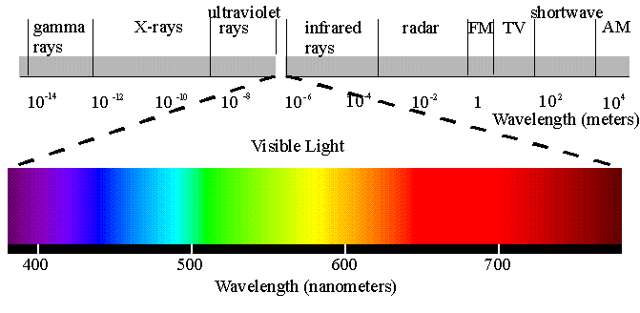
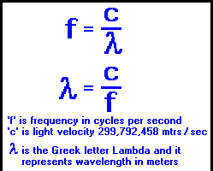
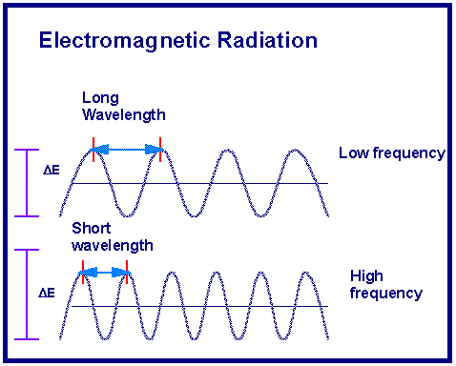
Wavelength and Frequency

Slide 12
Wavelength and Frequency Calculator
http://www.1728.org/freqwave.htm

Slide 13
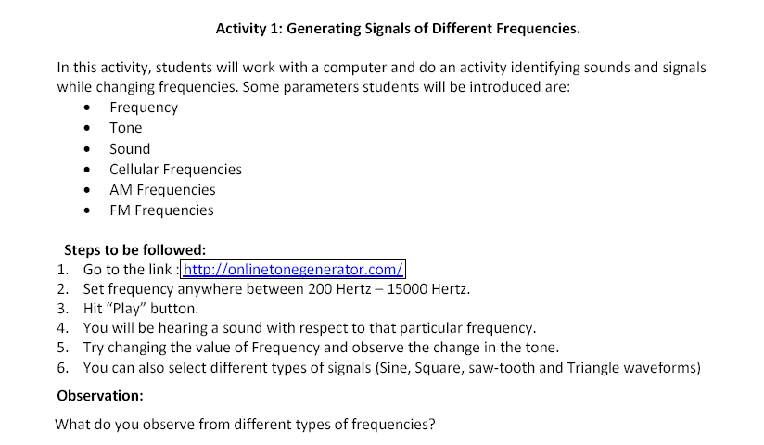
Activity 1

Slide 14
Activity 2 Building Radio Receiver
Soldering Video Tips Link:
http://www.youtube.com/watch?v=I_NU2ruzyc4

Slide 15
Summary Questions

