Slide 1
Perspectives of Conservation

Slide 2
The Circle of Life
A concept that shows all entities work together to create balance.
Entities can be: soil, air, wildlife, plants, weather, water, etc.
This encompasses both good and bad effects
This concept is thought of by most native peoples over the whole world, though each culture is slightly different from each other
When ecosystems are in balance, then everything works as it should.
We now have to include man-made entities such as pollution, waste water, monocultures, etc.
Notes:
The circle of life is sometimes called a food web. Food webs are a part of the circle, but they lack some of the basic entities that effect how the circle functions. For example, if there is a drought, the lack of water reduces the productivity of the plants, which in turn effects the whole food chain up. Another example is the lack of decomposition due to the removal of dead plant/animal matter. The excessive removal of these materials reduces the nutrients going back into the ground, which in turn effects the whole food chain. What are some other examples?
Man made materials and products are now included into the circle of life as they effect everything that happens. Pollution, waste water, synthetic chemicals, etc. are in the environment. Some organisms have adapted to take care of these man-made products, but too much may have disastrous effects. (There are bacteria and fungi species that can digest different types of plastic and Styrofoam in small amounts.)
Different cultures from around the world have different perspective on the circle of life, and even different bands of the same culture or even individuals might have different perspectives. Not any of them are wrong or right. The thing that remains constant between beliefs is the circle symbol.

Slide 3
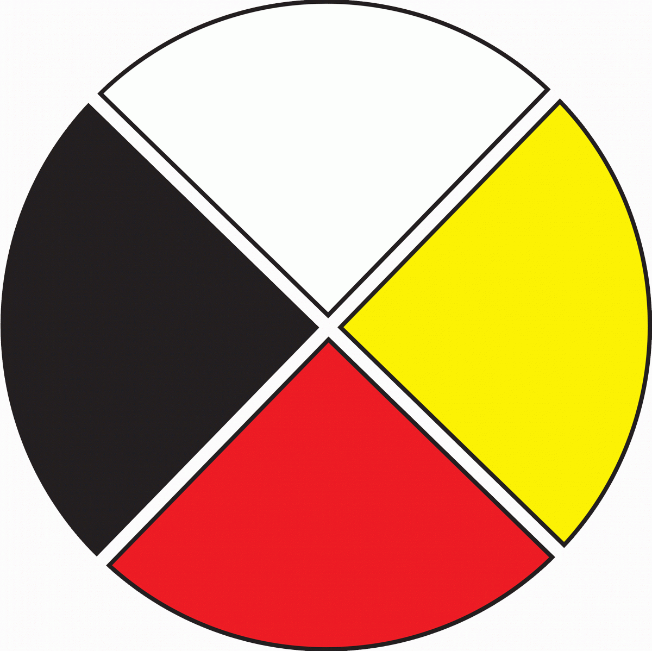
The Four Directions…A Dakota Perspective
For Dakota people, life has a circular symmetry that is rooted in spirituality and an understanding of relationships and how everything is connected. There are four seasons, four directions, and four stages in life – childhood, adolescence, adulthood, and elder status. We remember our ancestors and their prayers for our well-being today just as it is our responsibility to pray for those yet to be born.
The four directions and colors, as understood by Dakota people, are related to the relationships we have as human beings and our role within the cycle of life.
West/black symbolizes spiritual strength, doctoring, thunder beings and the buffalo nation
North/red signifies physical, natural law, common sense, truth and the elk nation
East/yellow symbolizes emotional health, new life, beginnings and the black tail deer nation
South/white signifies healing ways, wisdom, elders and the owl nation as well as being the door we pass through when we leave our earthly lives
Some elders have said that the four directions and colors represent the human races of Mother Earth. Each race is linked to the balance and harmony of nature and the cycle of life. The Red people are looked to for their wisdom in understanding relationships as well as the interwoven texture to the entire cycle of human existence.
Mitakuye oyasin…all my relations.
Notes:
Example of a Dakota story of the wheel of life, or as its commonly known now, the medicine wheel. This story is from the community of the Spirit Lake Nation in North Dakota. Even within the Spirit Lake Nation, individuals disagree and have different meanings for this symbol. Again, not one of them are wrong.
Cultures around the world have wheel symbols tied to life. Can you think of some of the most common ones?
(ying/yang, chakara, Buddhist wheel of life, pentagram, etc. – there will be more or other ones depending on the students background)

Slide 4
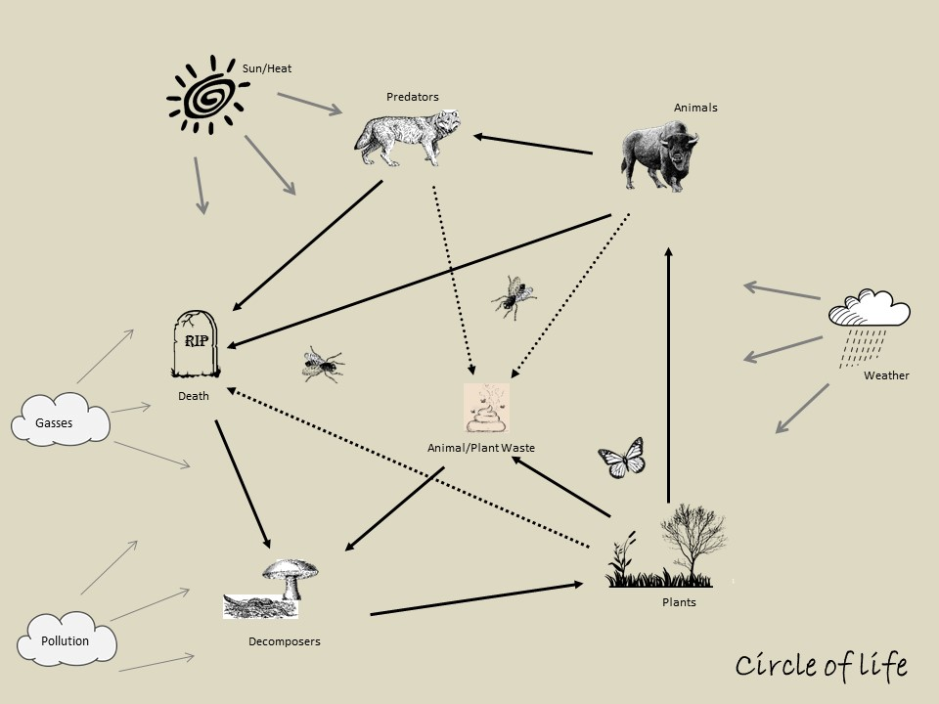
Notes:
When looking at ecology (or the environment) the circle of life is a little different, but follows the same circular pattern. There are no references to religion in this circle. The circle explains the relationship between animals, plants, and insects. Gasses, water, sunlight, wind, etc. also have to be included in the circle of life, as well as decaying matter and excrement.
This is a 2D view of the circle of life. If anyone of these elements are taken out of the circle, or reduced down to small numbers, the circle won’t flow. We’ll do an exercise in a moment to demonstrate this.
(talk through the diagram with the class)

Slide 5
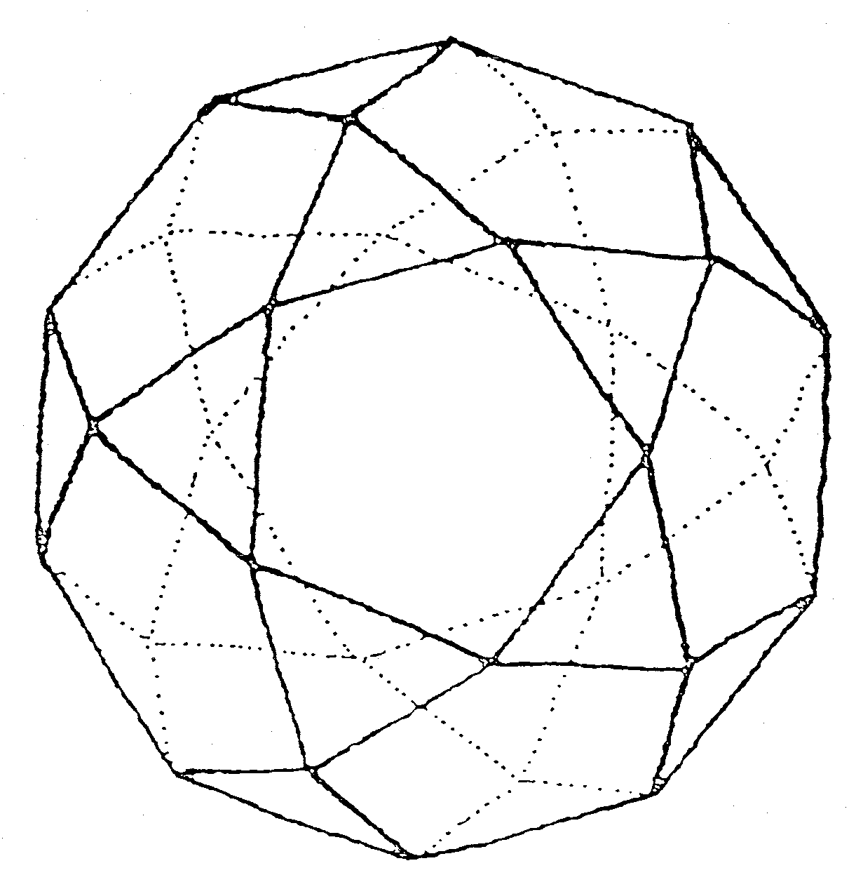
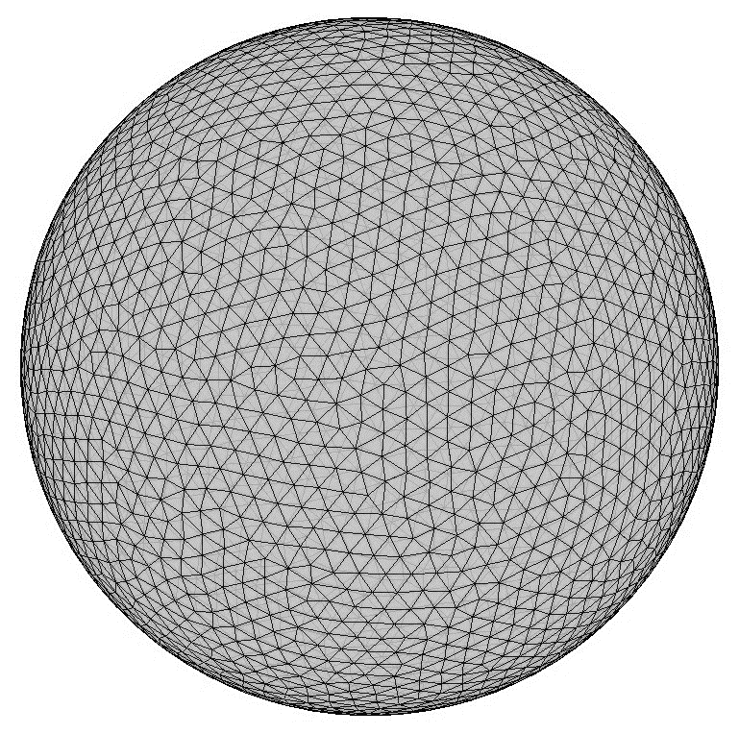
We say circle, but its really more of a sphere or a web…
The more connections you add, the more complicated and solid the sphere looks
Notes:
In reality, the circle of life is not 2D, but rather a 3D sphere or web. It can get very complicated. Each species on earth has its own wheel, theses wheels are connected together to larger wheels, and all are connected to even larger wheels. This

Slide 6
Eliminating elements from the circle….
Notes:
When elements are taken out of the circle, they create holes (white dots). These holes are sometimes filled with other items (i.e. if a species of grasshopper goes extinct, the bird that eats that grasshopper might just switch to another species of grasshopper to eat) but sometimes they are left empty. When these holes are left empty, it creates a chain reaction up the food chain and can cause larger consequences than we might imagine (grey holes). I.E., if a plant species dies out in an area, the insect that only eats that type of plant might die off as well, then the bird that eats this insect might start dying off, then the predator that eats the bird might be affected and so forth.

Slide 7
Adding elements in excess to the circle….
The circle will start to deform or even break apart
Notes:
Adding excess elements, such as pollution, gasses, or even over population of a species, the sphere can get distorted or even break apart. A distorted sphere will not function properly.
With time, nature will correct what is distorting the sphere, whether in allowing species to adapt or by correcting population problems. A broken sphere is harder to correct than a distorted one.
(move on to activity if there are no questions).

