Slide 1
Probability, Games & Sentiment Analysis
NATURE Sunday Academy Ravi Kiran Yellavajjala North Dakota State University

Slide 2
Obj.s & Outcomes | Probability | Monty Hall Game | Gambler’s Fallacy | Sentiment Analysis
Contents
Objectives and Learning Outcomes
Probability
Definition
Activity-1: Coin flipping experiment
Activity-2: Rolling dice experiments
Activity-3: Rolling biased dice
Monty Hall Game
Activity-4: Find the candy bag game
Explanation
Gambler’s Fallacy
Activity-5: Roulette game
Explanation: how casinos make money and mistakes while betting
Sentiment Analysis
Activity-6: analyze online reviews
Activity-7: building online word clouds

Slide 3
Obj.s & Outcomes | Probability | Monty Hall Game | Gambler’s Fallacy | Sentiment Analysis
Objectives and Learning Outcomes
Objectives:
Introduce probability and use this concept to understand Monty Hall game and Roulette.
Introduce sentiment analysis and use this concept to understand online reviews.
Learning Outcomes:
The participants will be able to use probability concepts in games and gambling.
The participants will be able to make better decisions based on the information they get from online resources.

Slide 4
Obj.s & Outcomes | Probability | Monty Hall Game | Gambler’s Fallacy | Sentiment Analysis
Probability
Definition:
Probability is the measure of the likelihood that an event will occur.
Mathematical definition:
Probability of an event ranges between ‘0’ and ‘1’.
Higher probability means that the event is highly likely.
P(E)=$\frac{\# of possibilities that meet a condition}{\# of equally likely possibilities}$
P(E)- probability of an event ‘E’
Note: P(E)$≥0$

Slide 5
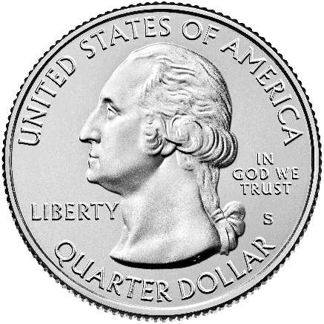
Obj.s & Outcomes | Probability | Monty Hall Game | Gambler’s Fallacy | Sentiment Analysis
Probability Activity-1: Coin Flipping
Flipping a quarter (5 mins):
Find a neighbor
One of you will flip the quarter 100 times
The other one will count the number of heads and tails
Report the number of heads, number of tails
Report the probability of getting heads/ tails
Use worksheet-1

Slide 6
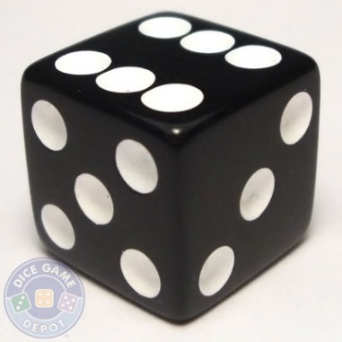
Obj.s & Outcomes | Probability | Monty Hall Game | Gambler’s Fallacy | Sentiment Analysis
Probability Activity-2: Rolling Dice
Roll a dice (10 mins):
Find a neighbor
One of you will roll the dice 100 times
The other one will count the number of 1’s, 2’s, 3’s, 4’s, 5’s and 6’s.
Report the probability of getting 1’s, 2’s, 3’s, 4’s, 5’s and 6’s. Use worksheet-2.
Now test your skills on a this new dice (10 mins)
Use worksheet-3

Slide 7
Obj.s & Outcomes | Probability | Monty Hall Game | Gambler’s Fallacy | Sentiment Analysis
Monty Hall Game
One of the three gift boxes has a candy bag/ gold coin and the other two boxes are empty.
Guess the right box to win the candy bag/ gold coin.
After you choose your box, I will reveal one empty box out of the other two boxes.
You can flip your choice after I reveal the empty box.
(30 mins)

Slide 8
Monty Hall Game (contd.)
Now play this game yourself
Find a neighbor to play this game
One of you will play the role of host and the other one is the player
The host will hide a gold coin below one of the three cups
Host will ask the guest to guess the cup with gold coin
The host will then reveal a cup other than the cup chosen by the player that does not have the gold coin
The player can either stay with their initial choice or switch their choice
Use worksheet-4 to record the options made by the player and the final outcome of the game.
Repeat this game at least 10 times
Did you observe a trend?

Slide 9
Obj.s & Outcomes | Probability | Monty Hall Game | Gambler’s Fallacy | Sentiment Analysis
Monty Hall Game: Explanation
Why Flipping helped you win? (use probability)
S
1st choice box | Box with candy | Open box without candy | Stay with choice | Switch choice
Box-1 | Box-1 | 2 or 3 | Win | Loose
Box-1 | Box-2
Box-1 | Box-3
Box-2 | Box-1
Box-2 | Box-2
Box-2 | Box-3
Box-3 | Box-1
Box-3 | Box-2
Box-3 | Box-3
No switching – probability – ___/9
Switching – probability – ___/9

Slide 10
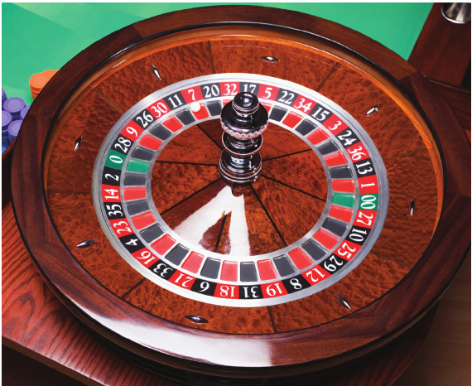
Obj.s & Outcomes | Probability | Monty Hall Game | Gambler’s Fallacy | Sentiment Analysis
Let’s play Roulette Wheel
(45 mins)
Option-1: Straight Up bet
Bet on a single number
Option-2: Bet on black/ red
Everyone gets 5 chances to play.
You can choose either option-1 or 2
You will play with me with the fake currency you were given.

Slide 11
Obj.s & Outcomes | Probability | Monty Hall Game | Gambler’s Fallacy | Sentiment Analysis
How Can Casinos Make Money
Straight Up Bet
Number of possibilities – 38; $Ω=\{0,00,…….36\}$
For example if you choose a number, say K and bet $1 on it
$$profit=\left\{\begin{matrix}−\$1;if number≠K \\ \$35;if number=K\end{matrix}\right.$$
For instance, if you play roulette 38 times and assuming that each outcome is equally likely
You will loose 37 times and win 1 time. That is you will win $35 and loose $37.
If you play 380 times, casino earns at least $20

Slide 12
Obj.s & Outcomes | Probability | Monty Hall Game | Gambler’s Fallacy | Sentiment Analysis
How Can Casinos Make Money
Bet on Black/ Red
Number of possibilities – 18 – black; 18 – red.
For example if you choose black, and bet $1 on it
$$profit=\left\{\begin{matrix}−\$1;if color≠black \\ \$1;if color=black\end{matrix}\right.$$
For instance, if you bet on black/ red 38 times and assuming that each outcome is equally likely
You will loose 20 times and win 18 times (remember the two green slots). That is you will win $18 and loose $20.
If you play 380 times, casino earns at least $20

Slide 13
Obj.s & Outcomes | Probability | Monty Hall Game | Gambler’s Fallacy | Sentiment Analysis
Gambler’s Fallacy
Strategy-1: I saw some of you betting on numbers that did not win the bet previously thinking that their turn is due.
Will this strategy-1 work?
Strategy-2: I saw some of you betting on numbers won the bet previously thinking that they are lucky/ more probable.
Will this strategy-2 work?

Slide 14
Obj.s & Outcomes | Probability | Monty Hall Game | Gambler’s Fallacy | Sentiment Analysis
Sentiment Analysis
Do you see online reviews before you purchase a product online?
Numeric ratings versus actual reviews – which is better?
How can we make life easier for prospective customers/ users?

Slide 15
Obj.s & Outcomes | Probability | Monty Hall Game | Gambler’s Fallacy | Sentiment Analysis
Review of Reviews
Please go through the reviews for Iphone-7 and a restaurant.
Identify the keywords used by the reviewers to describe the product, customer service, packaging and delivery. (look for adjectives)
Now open https://www.wordclouds.com/ and input all the keywords and create a word cloud.

Slide 16
Obj.s & Outcomes | Probability | Monty Hall Game | Gambler’s Fallacy | Sentiment Analysis
Word Cloud of my Lab
Go home and create word clouds for your family businesses/ services

Slide 17
For more information, 701-231-8400 ndepscor@ndus.edu
The 2018-2019 NATURE Sunday Academy program is supported by the National Science Foundation under NSF EPSCoR Track-1 Award OIA-1355466. Any opinions, findings, and conclusions or recommendations expressed in this material are those of the author(s) and do not necessarily reflect the views of the National Science Foundation.

Slide 18
THANK YOU
Questions?

