Slide 1
Characterization of Gold Nanoparticles with a Papercraft Spectrometer
Alexander Parent
Center for Sustainable Materials Science
North Dakota State University

Slide 2
Overview
Cultural Connection
How Does Light Interact with Matter?
Activity 1: Building a Papercraft Spectrometer
Lunch
What are Nanoparticles and how are they Made?
Activity 2: Synthesizing Gold Nanoparticles with Tea and Charactering their Interactions with Light
Wrap-up and Survey
Notes:
Overview of days activities. One activity in class before lunch, two lab activities after lunch.

Slide 3
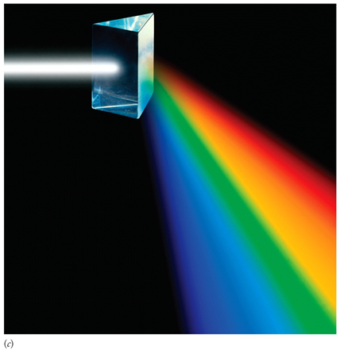
How Does Light Interact with Matter?
Light has multiple components (colors)
What happens when light interacts with matter?
What color do objects appear to us?
How do different light sources affect color?
Predict the difference between sunlight and a fluorescent light bulb.

Slide 4
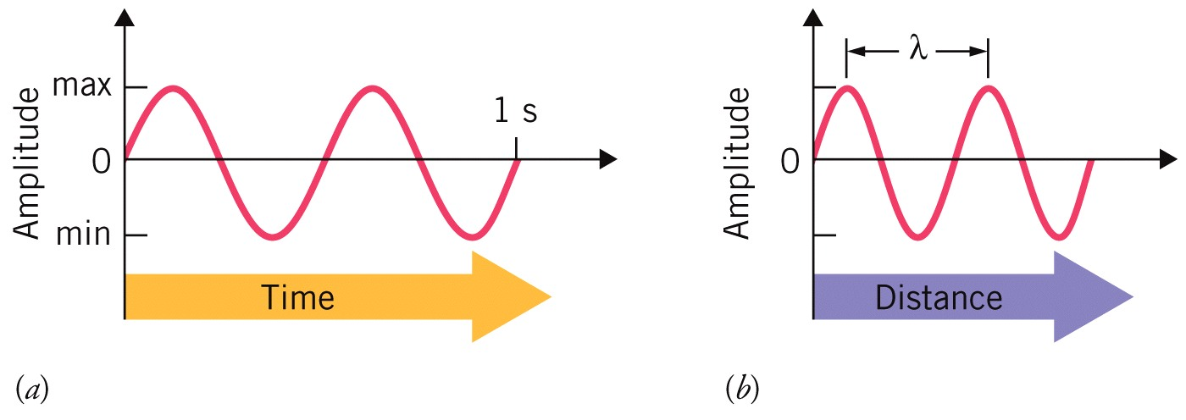
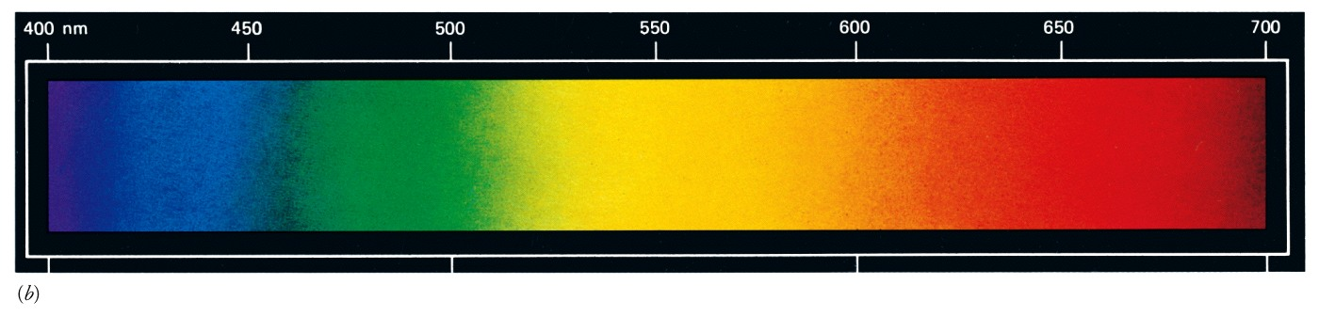
How Does Light Interact with Matter?
Light behaves as a wave
When waves pass through slits, they diffract
https://phet.colorado.edu/sims/html/wave-interference/latest/wave-interference_en.html
Different wavelengths (colors) of light diffract to different extents

Slide 5
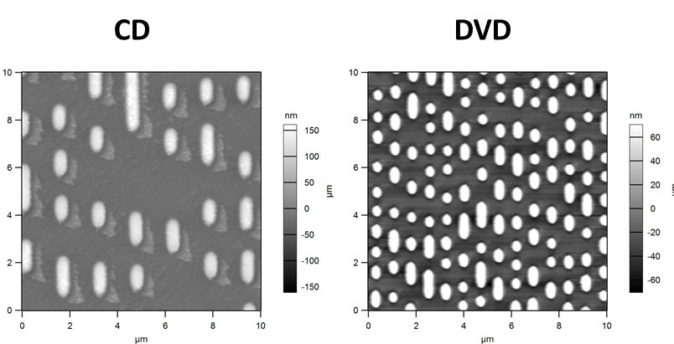
Interactions of Light and Nanomaterials
Visible light - between 400 and 700 nm
Nanomaterials about the same size as light
Nanomaterials can diffract light
Structural Color
Blue Morpho Movie
DVDs have same type of structure!
Other Examples?
“Nanoscale Analysis – Harvard CNS” Harvard University 09/2016 Web 07/28/2019 https://cns1.rc.fas.harvard.edu/nanoscale-analysis/

Slide 6
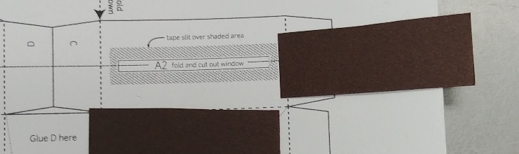
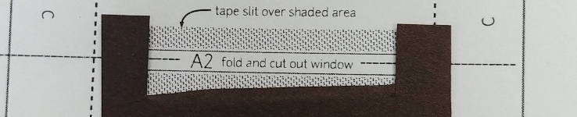
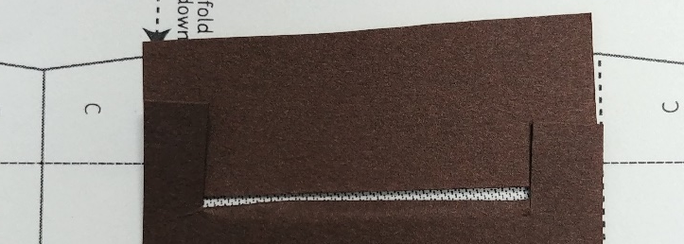
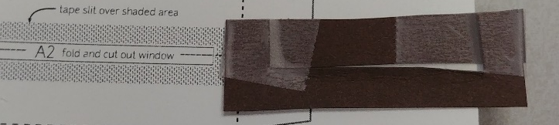
Activity 1: Building a Papercraft Spectrometer
Construct your light entry slit using the black cardstock (see screen).
Carefully cut out the papercraft spectrometer along the solid shaded lines.
Crease the lines on windows A1, A2, and A3, with a pen, then cut them out.
Fold the spectrometer on the dashed and dotted lines.
Tape the slit over window A2.
Cut a DVD wedge to match the marking on window A3.
Tape the wedge on the window.
Seal your spectrometer by taping the flaps to the indicated locations.
Test your spectrometer by holding window A3 to your phone camera and taking a picture of sunlight and a fluorescent lightbulb.

Slide 7
How does your spectrometer work?
What does your spectrometer slit do?
What does the DVD do?
What does your cellphone camera do?
Notes:
Parts used, how light travels/is detected

Slide 8
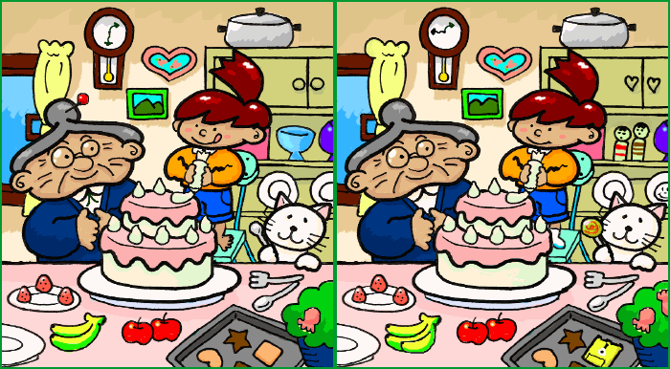
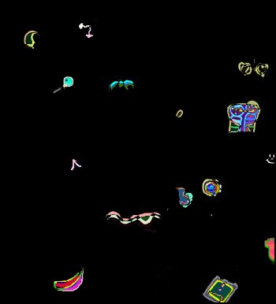
Comparing different images
How many differences are there between the picture on the left, and the picture on the right? (5 min)
Difference map created by Dr. Parent using ImageJ https://imagej.nih.gov/ij/index.html
Muband “Spot the Difference” 3/30/2007 Web 07/28/2019 https://commons.wikimedia.org/wiki/File:Spot_the_difference.png
Much easier to see differences by subtracting one image from the other
Difference spectra used to detect changes in scientific measurements

Slide 9
Lunch Break
Notes:
Mission of the CSMS is developing more sustainable materials using chemistry and engineering. Multiple research topics including: 1) synthesis of polymers from bio-based monomers, 2) development of self-degrading polymers, and 3) incorporation of natural materials into materials to develop new properties.

Slide 10

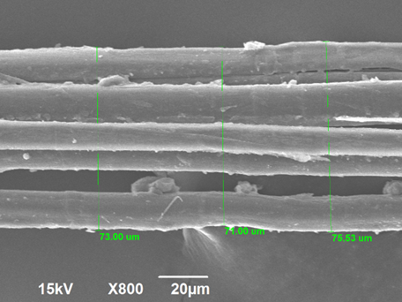
CSMS: Center for Sustainable Materials Science
Notes:
Mission of the CSMS is developing more sustainable materials using chemistry and engineering. Multiple research topics including: 1) synthesis of polymers from bio-based monomers, 2) development of self-degrading polymers, and 3) incorporation of natural materials into materials to develop new properties.

Slide 11
What are Nanoparticles and How are They Made?
Particles with three dimensions between 1 and 100 nm
Produced naturally during combustion (of wood, coal, etc)
Can be made synthetically via a top-down (wearing-away) or bottom-up (growing) approach
Colloids are suspensions of nanoparticles in a solution
Typically formed via bottom-up approach
To make a colloid need to keep nanoparticles from:
  Getting too big
  Sticking to one another
  Precipitating out of solution
Notes:
Overview of days activities. One activity in class before lunch, two lab activities after lunch.

Slide 12
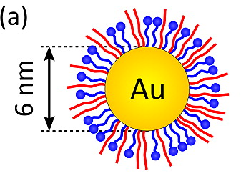
Making Colloids
To make a colloid need to keep nanoparticles from:
  Getting too big
  Sticking to one another
  Precipitating out of solution
Capping molecules can keep nanoparticles from getting too big and sticking to one another
Surfactants keep nanoparticles from precipitating
What is a surfactant?
Molecule that stabilizes the interaction between a liquid and another substance
Lee, H.-Y.; Shin, S. H. R.; Abezgauz, L. L.; Lewis, S. A.; Chirsan, A. M.; Danino, D. D.; Bishop, K. J. M. J. Am. Chem. Soc. 2013, 135 (16), 5950–5953.
Notes:
Overview of days activities. One activity in class before lunch, two lab activities after lunch.

Slide 13
Making Gold Nanoparticles
Start from a molecular gold source: HAuCl₄
React with tea, which contains:
  A) Antioxidants
  B) Surfactants
What will happen when the gold and tea are mixed?
HAuCl₄ will oxidize (remove electrons from) the antioxidants in the tea, forming gold metal
As gold metal forms, it will be capped by surfactants, preventing the gold from growing larger than the nanoscale
Notes:
Overview of days activities. One activity in class before lunch, two lab activities after lunch.

Slide 14
Activity 2: Synthesizing Gold Nanoparticles
Put on your gloves and safety glasses.
Collect 5 mL of chloroauric acid solution, 5 mL of tea, and 100 mL of deionized water from the front of the room using 3 of your flasks/beakers.
Measure the light absorption of the HAuCl₄ solution.
Using your graduated cylinders, add 1 mL of tea and 20 mL of water to a small flask or beaker and stir gently.
While stirring, add dropwise 1.0 mL of 5 mM chloroauric acid to your diluted tea using your graduated pipette.
Record your observations.
Using your graduated cylinders, add 1 mL of tea and 40 mL of water to a small flask and stir gently.
While stirring, add dropwise 1.0 mL of 5 mM chloroauric acid to your diluted tea using your graduated pipette.
Record your observations.
Place the beakers containing your gold nanoparticle solutions between your papercraft spectrometers and your light source and take a picture. (Note, it can be difficult to get a good picture, try different positions for your spectrometer/beakers).
Compare your pictures to your picture of the light source using spectralworkbench or imageJ.

Slide 15
Wrap-up
How did the colors of the gold nanoparticle solutions differ between the two solutions?
Why were the colors different?
Could you detect these differences using your spectrometer?
What was the greatest limitation of your spectrometer for measuring the color of the solutions?
What are some other experiments you could use your spectrometer for?
Notes:
Overview of days activities. One activity in class before lunch, two lab activities after lunch.

