Slide 1
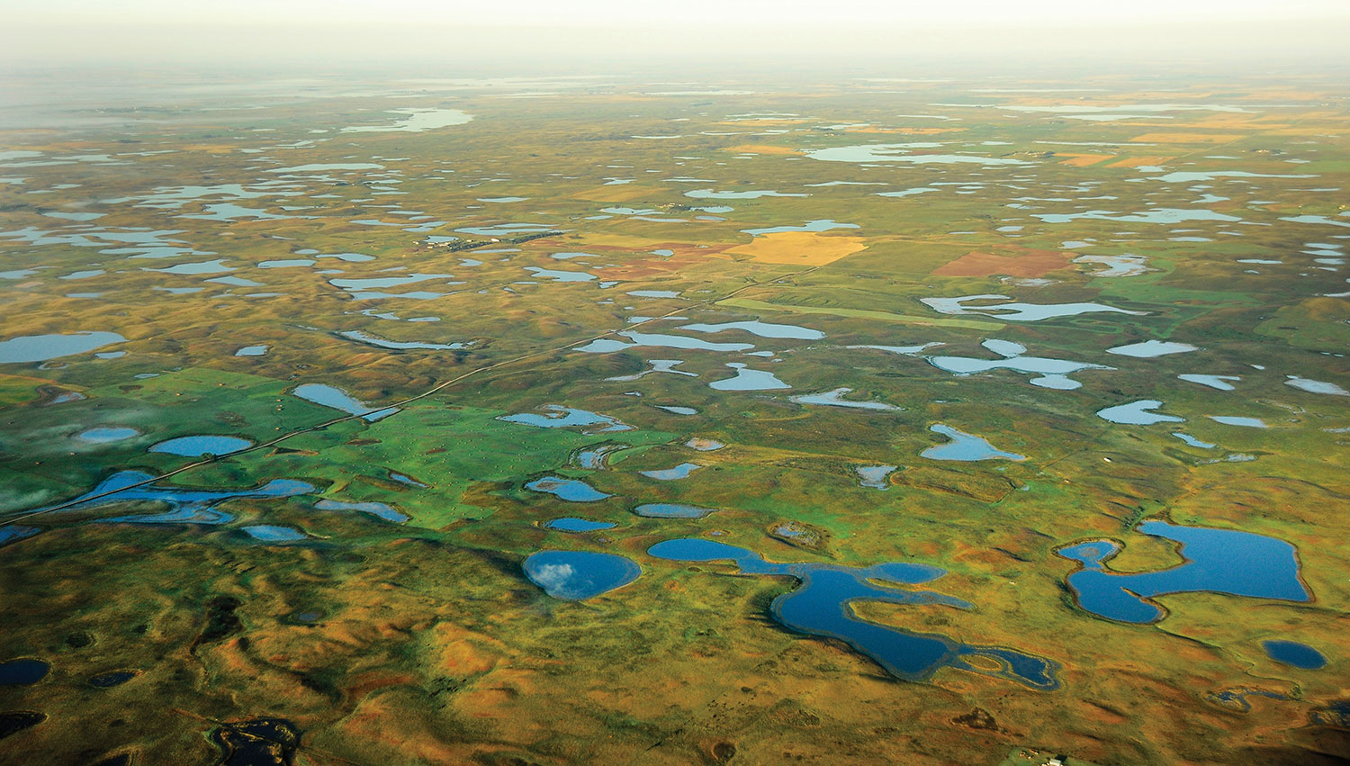
What lives in Wetlands?
Image: ND Game & Fish
NATURE Academy Jon Sweetman, North Dakota State University

Slide 2
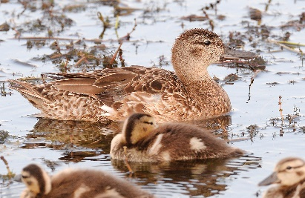
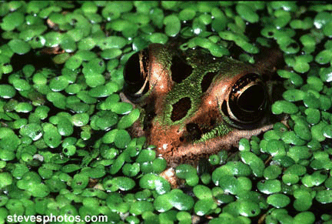
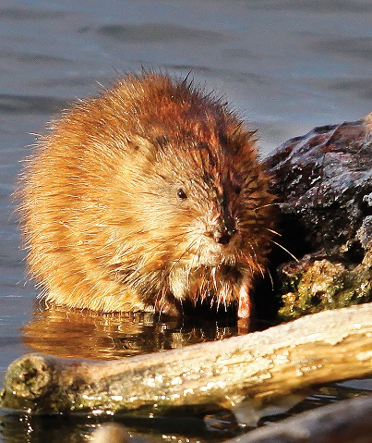
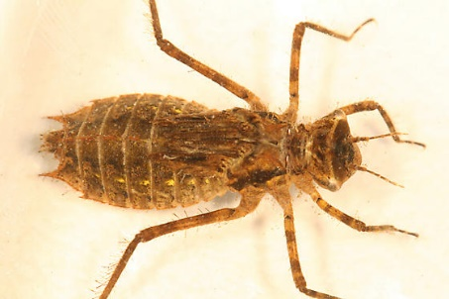
Goals for today:
Image: ND Game & Fish
Learn about the importance of wetlands and the interrelationships of wetland organisms
Understand and appreciate that all organisms, not just the large ones, have an important role in a wetland community
Understand how environmental changes can alter habitat for aquatic organisms
Image: ND Game & Fish
Image: bugguide.net

Slide 3
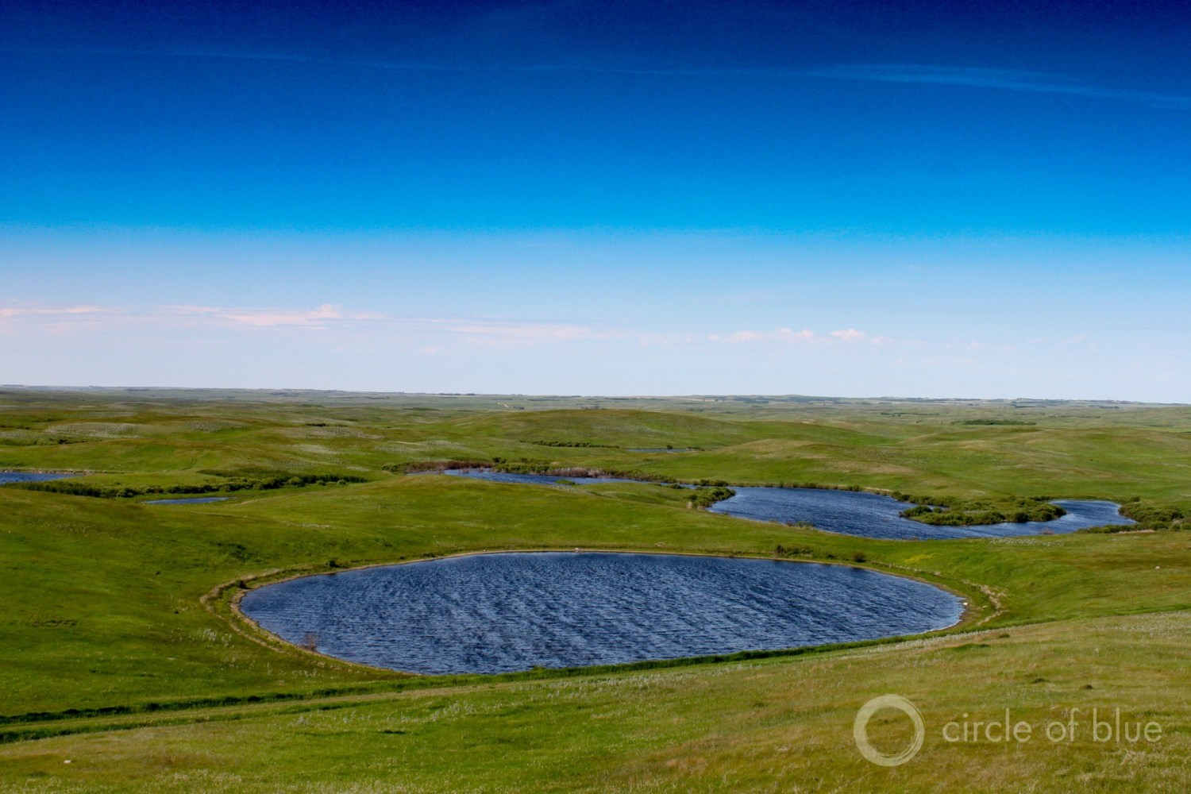
Did you know?
There are over a million wetlands in North Dakota!

Slide 4
What lives in Wetlands? https://youtu.be/oo675fw9PTA

Slide 5
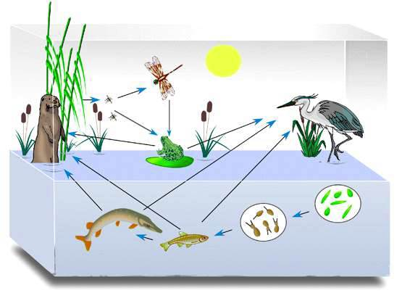
Some Background Info: Food Webs
All life and things around them are connected in delicate balances called "ecosystems.“
Living things do one of three different jobs to maintain ecosystems - they are either producers, consumers or decomposers
Producers are green plants. They use the sun's energy to manufacture their own food
Consumers are living things that eat other living things.
Decomposers "break down" dead plant and animal material into abiotic elements. Decomposers are recyclers

Slide 6
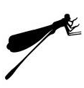
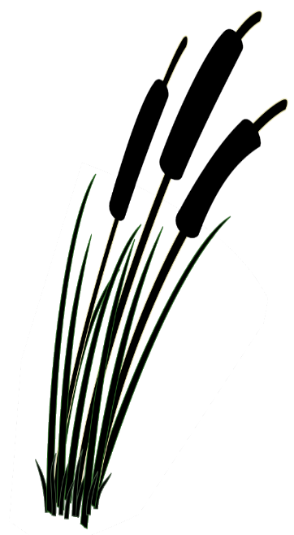
Activity #1: The Web of Life
1. Each of you will pick a card that has a picture and name of a component of a wetland ecosystem. You will become that component
2. We will form a circle and explore how your individual components interact with each other.

Slide 7
Recap: Wetland Food Webs

Slide 8
Ecosystem Tag
You will be assigned a role in the ecosystem:
Producers are green plants. They use the sun's energy to manufacture their own food
Consumers are living things that eat other living things.
Decomposers "break down" dead plant and animal material into abiotic elements. Decomposers are recyclers
2. In the playing area, there are piles of beanbags. These represent abiotic resources (e.g nutrients, food, water)
3. The game involves the basic chain of abiotic components to producer, producer eaten by consumer, and consumer broken down by decomposer to return abiotic components to the environment. The overall idea is to maintain the ecosystem, while each group fulfills its goal

Slide 9
Ecosystem Tag
Game Rules:
1. Producers are the only players who can take beanbags from the piles. A safety zone (one foot inside the hula hoop) around the pile protects a producer from being tagged while he or she is picking up an object. The goal of the producers is to get all the beanbags (or as many as possible) out of the safety zones and hold onto them.
2. Consumers get beanbags by making a two-handed tag on a producer holding one. The goal of consumers is to get as many beanbags as possible from producers and keep them.
3. Decomposers can only get beanbags by making a two-handed tag on a consumer holding one. When decomposers get a beanbag, they return it to the safety zone. The goal of decomposers is to get all the beanbags (or as many as possible) back to the safety zones.
4. Players can hold only one beanbag at a time. When players are tagged, they must give up the beanbag they are holding. Players can toss and pass beanbags to members of their own group.

Slide 10
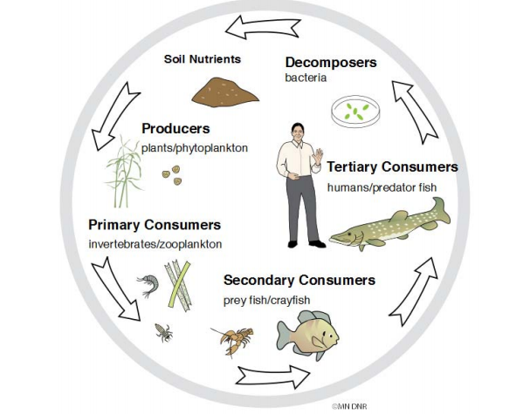
Recap: Ecosystem Tag

Slide 11
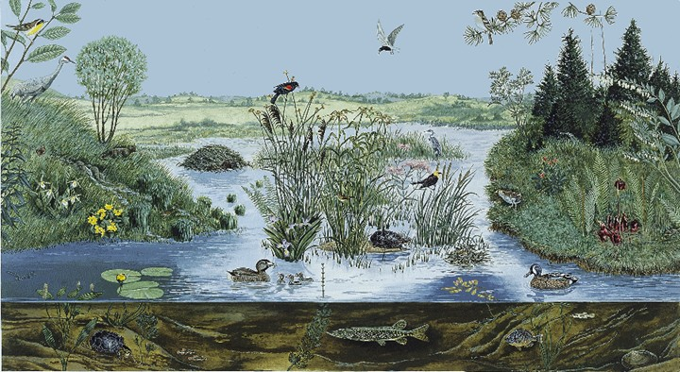
Background Info: Habitats
A habitat is the place where an organism lives, feeds, breeds and shelters.
Think about your own home. Why is having good habitat important for organisms?

Slide 12
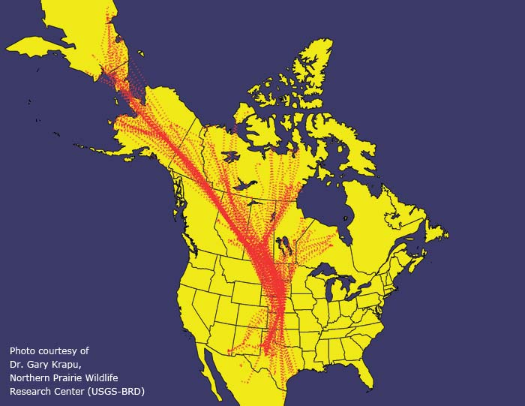
Activity #3: Migration Game

Slide 13
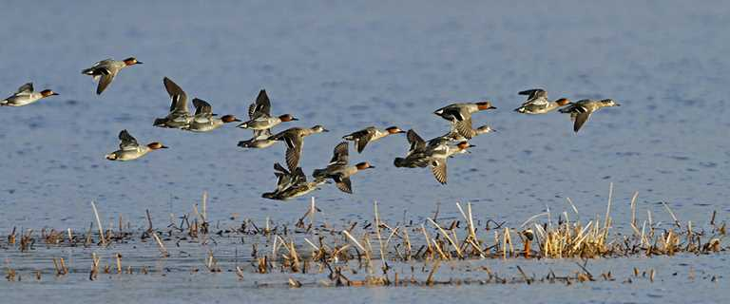
You are now all waterbirds and are migrating along the Central Flyway!
Many factors will limit the survival of populations of migrating waterbirds.
Some involve changes in the wintering and nesting habitats.
Sometimes the area of available habitat is reduced or impacted.
How do those impacts affect waterbirds?

Slide 14
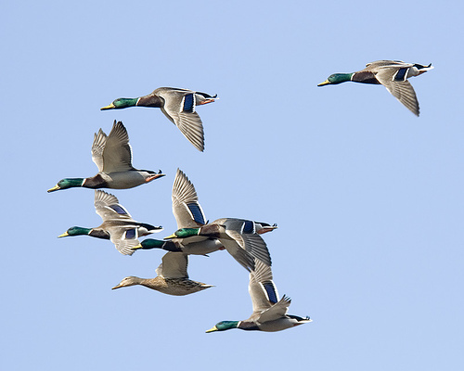
Head to the hallway
to try out the activity!

Slide 15
Can you recognize common plants, animals and insects found in wetlands? See for yourself and take this fun quiz as you go on a Wetland Odyssey!

