Slide 1
Hormone signaling pong
Britt Heidinger and Tim Greives
Biological Sciences
North Dakota State University

Slide 2
Learning objectives
Define a hormone and describe how endocrine signaling works.
Create a box and arrow model of glucose regulation by insulin and glucagon.
Use data to diagnose a patient with Type 1 or Type 2 diabetes.
Predict how glucose levels will change over time.

Slide 3
Create a box and arrow model using the following terms:
Pancreas
Insulin receptor
Muscle cell
Insulin
Blood
Glucose

Slide 4
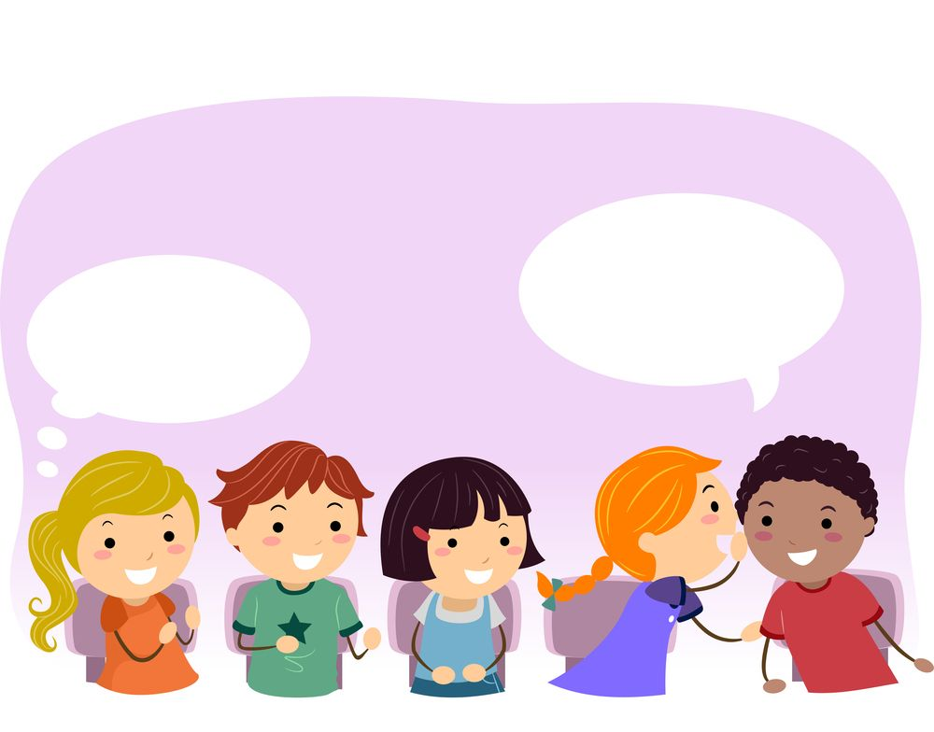
What are hormones?

Slide 5
What are hormones?
“Hormones are chemicals made by endocrine glands, secreted into the blood in response to a signal, and transported to target tissues where they bind to receptors and have effects”

Slide 6
What are some of the hormones you have heard of?

Slide 7
What types of processes do hormones regulate?

Slide 8
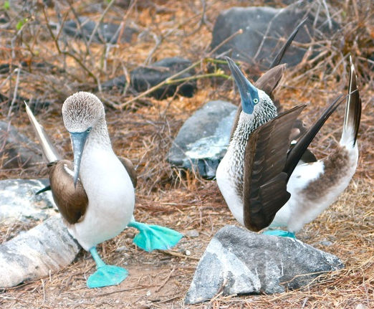
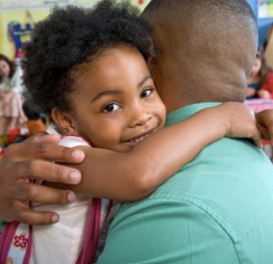
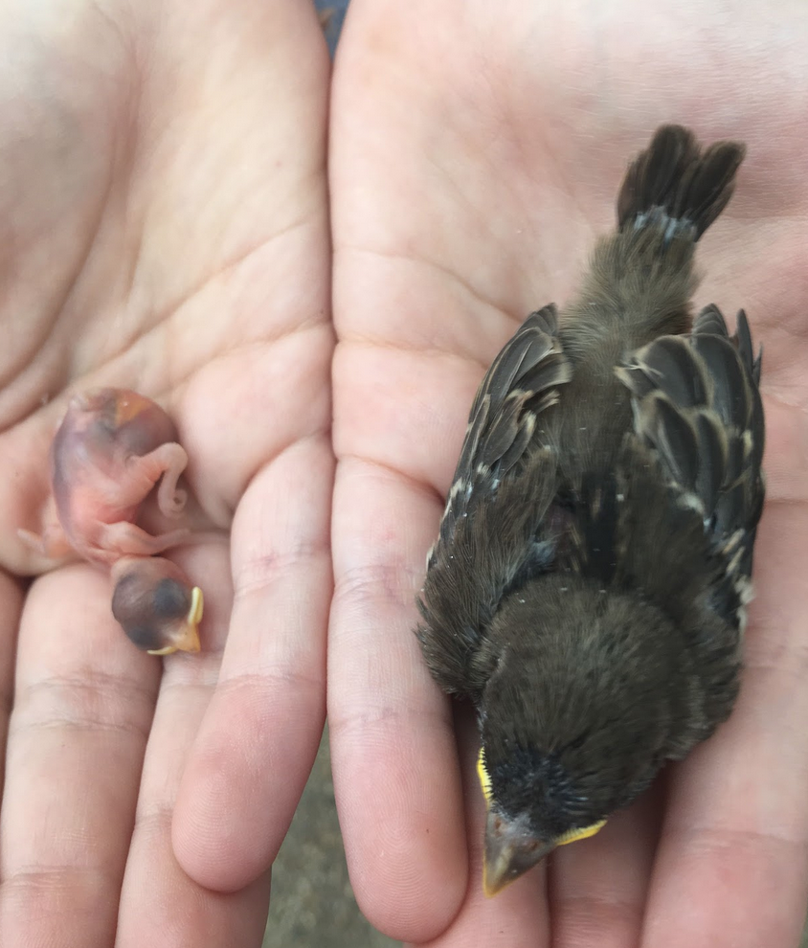
What types of processes do hormones regulate?

Slide 9
Activity 1: hormone signaling game 1 round 1
One player on each team throws the ping pong balls.
When I ping pong ball lands in a solo cup another player transfers a piece of candy from the blood bucket to the cell bucket.
After 2 minutes switch roles.
After 2 more minutes record the number of candy pieces that were transferred.
Graph results for each team on the board.

Slide 11
Activity 1: hormone signaling game 1 round 2
Reduce the number of ping pong balls for each group by half.
Predict how the results for round 2 might differ from round 1.
One player on each team throws the ping pong balls.
When I ping pong ball lands in a solo cup another player transfers a piece of candy from the blood bucket to the cell bucket.
After 2 minutes switch roles.
After 2 more minutes record the number of candy pieces that were transferred.
Graph results for each team on the board.

Slide 12
Activity 1: hormone signaling game 1 round 3
Now start with the same number of ping pong balls as in round 1 but reduce the solo cups by half.
Predict how the results for round 3 might differ from rounds 1 and 2.
One player on each team throws the ping pong balls.
When I ping pong ball lands in a solo cup another player transfers a piece of candy from the blood bucket to the cell bucket.
After 2 minutes switch roles.
After 2 more minutes record the number of candy pieces that were transferred.
Graph results for each team on the board.

Slide 13
Activity 1: hormone signaling game 1
Did the results differ among rounds?
How so? Why?
Why could this be important?

Slide 14
Hormones are involved in helping you to process your lunch!
Half of the students will use a glucose test strip and the other half will use a glucose test strip at the end of activity 3.

Slide 15
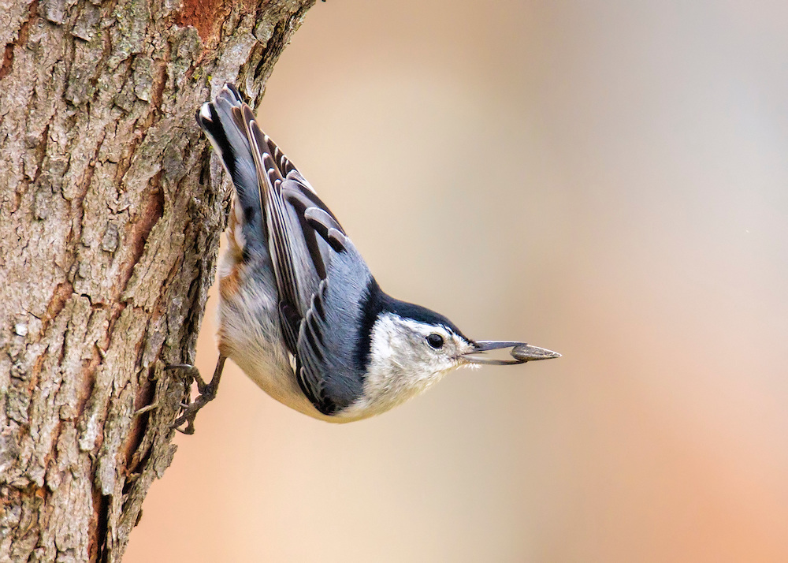
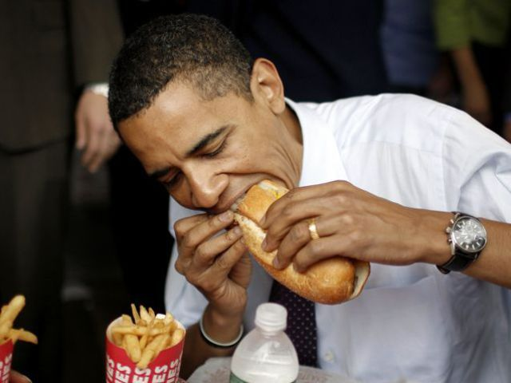
Energy is required for cellular activity

Slide 16
Hormones help you process your lunch!
The food we eat is made up of carbohydrates, lipids, and proteins.
Can you think of foods high in carbohydrates? Anything in our lunch?
Carbohydrates are primarily absorbed as glucose, which can be used right away for energy or growth or stored in the liver and muscles.
Glucose needs to be maintained at healthy levels, not too high and not too low.

Slide 17
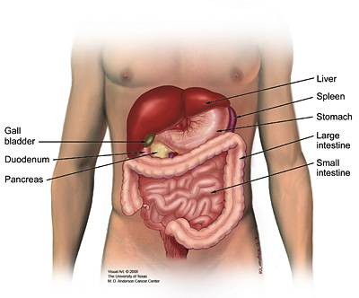
Insulin
One hormone that is important for regulating glucose levels in insulin.
Insulin is made by the beta cells of the pancreas.
After eating, glucose levels rise, and the pancreas secretes insulin into the blood.
Insulin binds to receptors on muscle and liver cells and the cells uptake glucose, which lowers glucose levels in the blood and brings it into balance.

Slide 18
Activity 2: glucose test strips and discussion
Half of the students will measure their blood glucose levels using test strips and the other half will measure them at the end of activity 3.
How might glucose levels differ between groups? Why?
Now look back at the box and arrow diagrams that you drew at the beginning, do you want to modify them in anyway?
Using this specific example of insulin signaling, what did the different elements of the game represent?

Slide 19
Activity 3: What happens when glucose levels get out of balance?
Diabetes is a disease where glucose levels are too high because the pancreas is unable to make insulin (Type 1) or the cells are not sensitive to insulin (Type 2).
Type 1, accounts for about 10% of cases, autoimmune, often symptoms start during adolescence. Which game situation was this?
Type 2, increasing in prevalence, associated with certain diets and life-style choices. Which game situation was this?

Slide 20
Activity 3: Diabetes case study
Work in groups of 2-3 to complete the case studies
 | Your patient | Normal range
Age of patient
Active lifestyle (Y/N)?
Healthy food habits (Y/N)?
Thirsty (Y/N)?
Blood Pressure |  | <120/80
Pulse (bpm) |  | 60-100
Fasting blood glucose (mg/dl) |  | 75-105
Blood sodium (nmol/L |  | 135-145
Blood potassium (nmol/L) |  | 3.5-5.0
Glucose tolerance test |  | <200
C-peptide test (ng/ml) |  | 0.5-2.0

Slide 21
Activity 3: What happens when glucose levels get out of balance?
Which patient(s) have diabetes?
Could you tell which type of diabetes it was?
What evidence did you use?
Now measure glucose levels using the test strips for the second group!

Slide 22
Activity 4: Hormone signaling game 2
Blood glucose levels are maintained in balance by two hormones, insulin is secreted when levels are high, so glucose enters cells and lowers levels in the blood.
But when individuals have not eaten for awhile and glucose levels get too low, another hormone, glucagon, is secreted by the pancreas and released into the blood.
Glucagon binds to receptors in the liver and the liver releases glucose stored as glycogen into the blood and raises blood glucose levels.

Slide 23
Activity 4: Hormone signaling game 2
Two players stand at opposite ends of the table. One player throws the orange balls (insulin) into the red solo cups (insulin receptors). The other player throws the white glucagon balls into white solo cups (glucagon receptors).
Each time an orange ball lands in a red cup, one piece of candy is removed from the blood bucket and placed into the liver cell bucket. Each time a white ball lands in a white cup, one piece of candy is removed from the liver bucket and placed back in the blood bucket.
Whenever the glucose levels in the blood go above or below the line, make a check mark on the date sheet.
How many times did glucose levels get out of balance?
Graph results for each team on the board.

Slide 24
Add the following terms to your box and arrow diagram
Glucagon receptor
liver cell
Glucagon
Glycogen

Slide 25
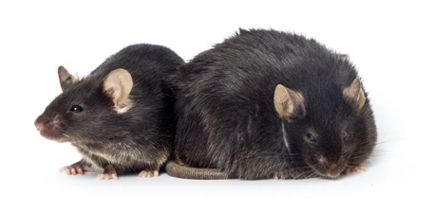
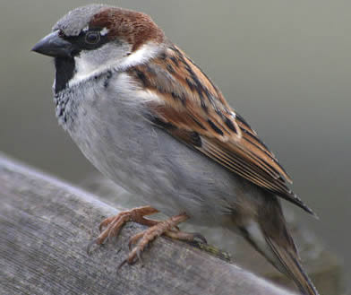
Which animal do you think has the highest glucose levels?

Slide 26
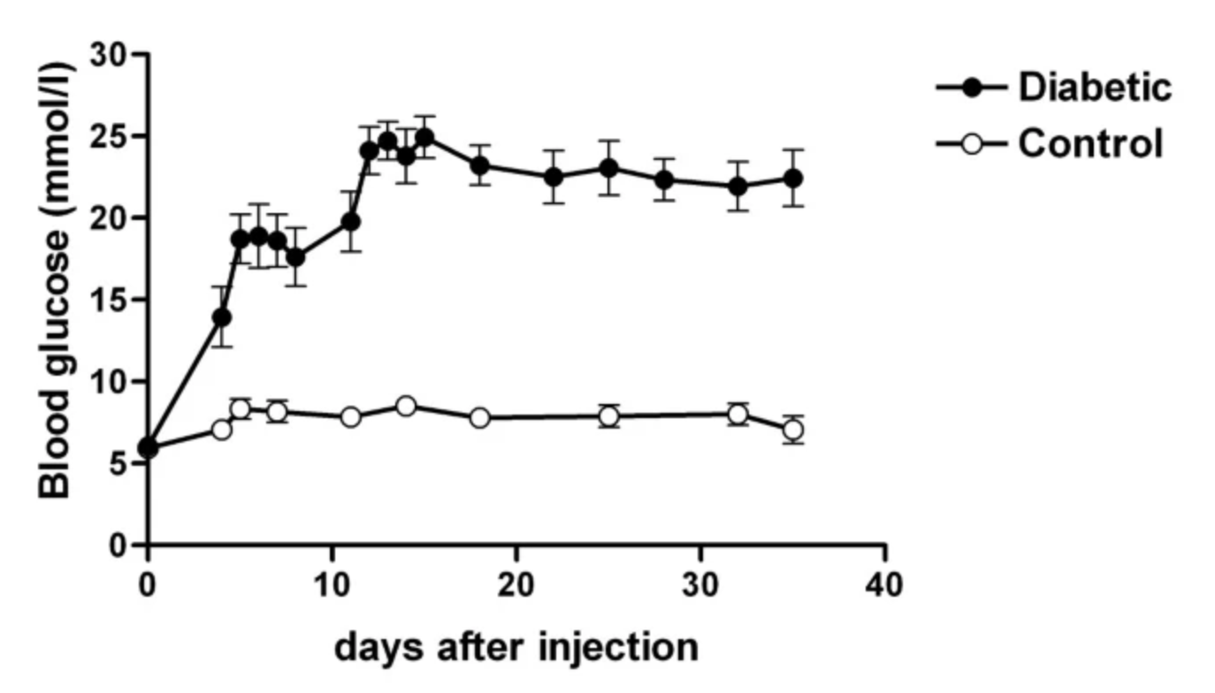
Which animal do you think has the highest glucose levels?

Slide 27
Which animal do you think has the highest glucose levels?

Slide 28
Why do birds have such high glucose levels and how are they able to avoid getting diabetes?

Slide 29
What types of things can we do to keep our blood glucose at healthy levels?

