Slide 1
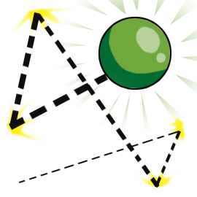
Making Slime and Bouncy Balls Using Household Polymer Materials
Guodong Du, Binglin Sui, Julia Xiaojun Zhao
Wen Sun, Helen Wu, Di Sun, Vladimir Zotov, Zachary Bailey
( Department of Chemistry, University of North Dakota)
Austin Allard
(Turtle Mountain Community College)

Slide 2
Learning goals and outcomes
The basics of plastics and polymers.
The importance of polymer materials in everyday life.
The impact of crosslinking on polymer properties
How the materials properties can be manipulated.

Slide 3
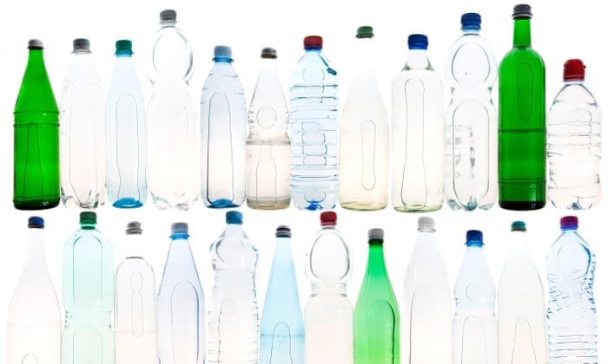
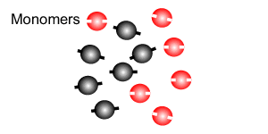
Polymers
Plastics are made of long chain-like molecules called polymers.
Polymers are made from monomers

Slide 4
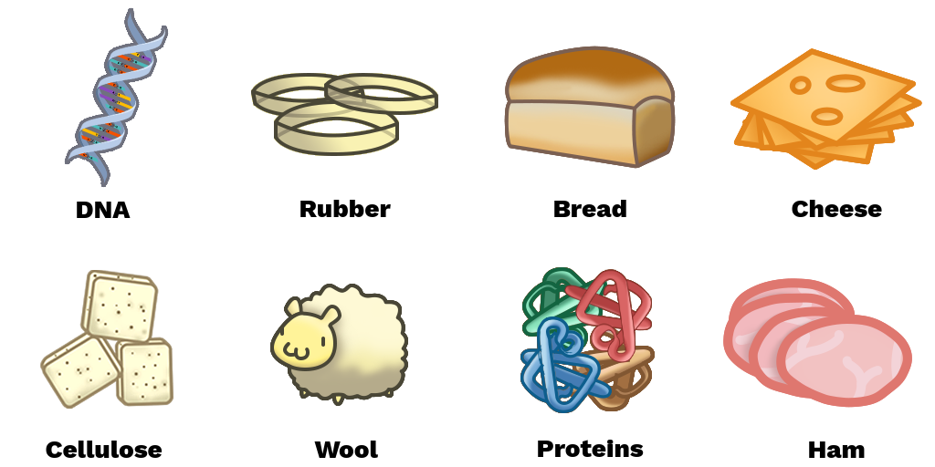
Natural Polymers

Slide 5
Synthetic Polymers
Notes:
A number surrounded by a triangular shape consisting of three recycling arrows is stamped on the plastic object which tells its component. The so called “big six” plastics earlier are often applied in their “pure” form.
A Whopping 91% of plastic isn't recycled. Billions of tons of plastic have been made over the past decades, and much of it is becoming trash and litter.

Slide 6
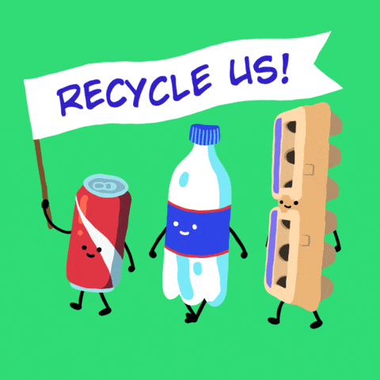
Synthetic Polymers
6
Notes:
A number surrounded by a triangular shape consisting of three recycling arrows is stamped on the plastic object which tells its component. The so called “big six” plastics earlier are often applied in their “pure” form.
A Whopping 91% of plastic isn't recycled. Billions of tons of plastic have been made over the past decades, and much of it is becoming trash and litter.

Slide 7
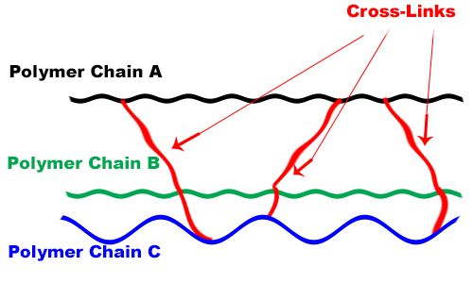
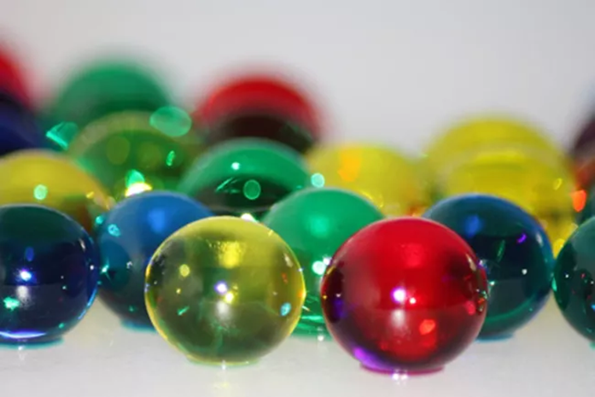
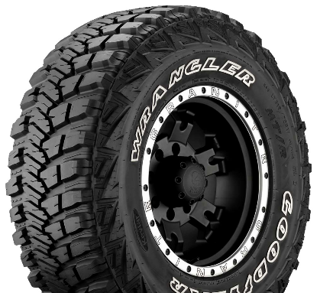
Cross Linking between polymer chains
Vulcanization
Modification of natural rubber by sulfur cross-linking.
Soft, Gummy, sticky, and less elastic
Hard, non-sticky and more elastic
Notes:
A common strategy to reinforce certain properties is through cross-linking, i.e. making connections, or bonds, between different polymer chains. The result is an interconnected polymer matrix that can have wide range of properties.

Slide 8
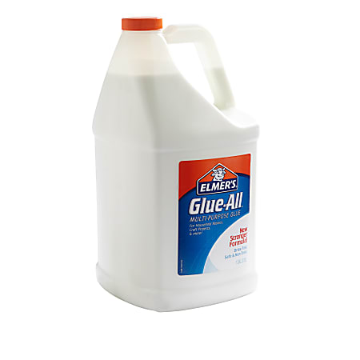
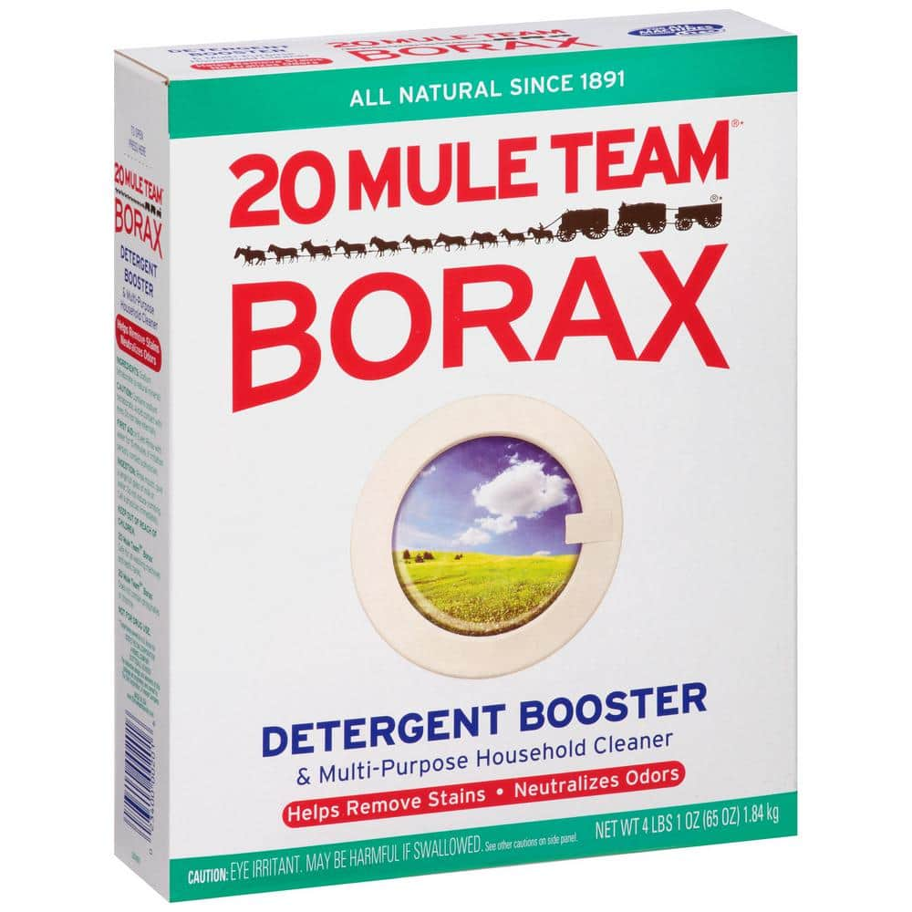
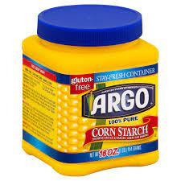
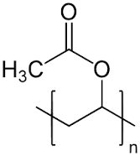
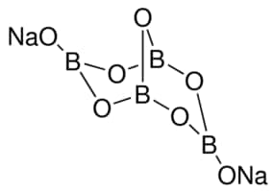
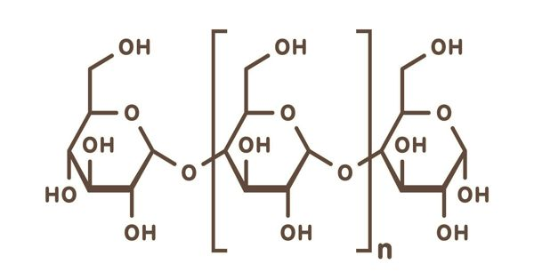
Making Cross-linked Polymers Using household items
polyvinyl acetate
sodium tetraborate
polysaccharide
Notes:
We will produce cross-linked polymers from common household items such as glue, borax and cornstarch.
The glue contains polyvinyl acetate, which form polyvinyl alcohol upon reaction with water.
Borax contains primarily sodium tetraborate that has a ring structure, and cornstarch is a natural polysaccharide that contains many hydroxyl groups

Slide 9
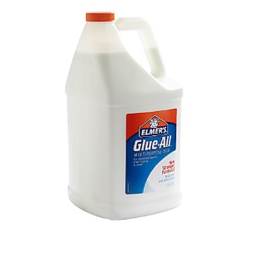
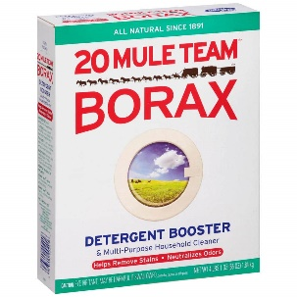
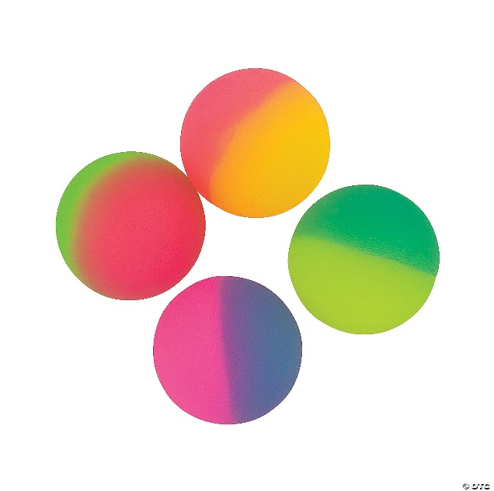
Making Bouncy Balls
Notes:
When mixed they form extensive hydrogen bonding, leading to a 3-D structure that allows water to hide in holes in the network. By modifying the compositions and their ratios, the polymeric materials can be obtained with different properties such as elastic (stretch without breaking) and cohesive (the fibers tend to attract to each other).

Slide 10
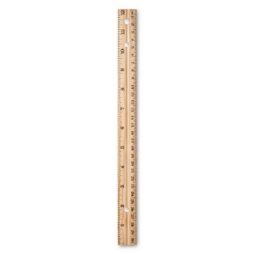
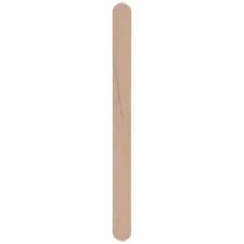
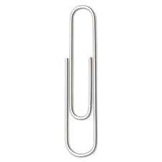
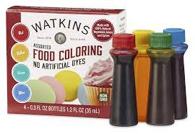
Materials needed
Beakers
Rulers
Wood sticks
Plastic cups
Plastic spoons
Paperclips
Elmer’s glue
Borax
Cornstarch
Food coloring

Slide 11
Activity 1: Modeling Polymers with Paperclips
Polymer 1
A polymer chain
Polymer 2
A co-polymer
Polymer 3
An alternating co-polymer
Polymer 4
A crosslinked polymer network
Notes:
Take a set of 12 paperclips of the silver color. Join them together to form a long chain. This shows how the same monomer can be linked together to form a polymer chain.
2. Take two sets of 6 paperclips of different colors (e.g. 6 silver, and 6 blue). Join one color into a chain first, and then the other color. Now you have a block co-polymer with two different segments.
Take another two sets of 6 paperclips of different colors (e.g. 6 silver, and 6 blue). Join them in an alternating fashion (e.g. silver-blue-silver-blue). Now you get an alternating co-polymer.
4. Now you have three polymer chains (you can make more if you want). Place them together in parallel. Use another different colored paperclips with regular placement to connect these separate polymer chains together. Now you get a sheet of paperclip chains, or crosslinked polymer network.

Slide 12
Activity 2: Making Slime
Step 1
Step 2
Step 3
1 teaspoon of Borax
+
1 cup of warm water
4 ounces of glue
+
a drop of food coloring
Cup 1
Cup 1
Cup 2
Cup 2
Cup 2

Slide 13
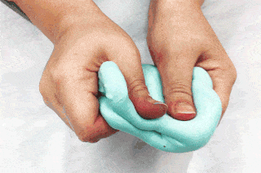
Activity 2: Making Slime

Slide 14
Activity 3: Making Polymer Bouncy Balls
3 tablespoon of glue
+
1 teaspoon of water
+
1 tablespoon of cornstarch
+
1 tablespoon of borax
3 tablespoon of glue
+
1 teaspoon of water
+
1 tablespoon of borax
3 tablespoon of glue
+
1 tablespoon of cornstarch
+
1 tablespoon of borax
1 drop food coloring
1 drop food coloring
1 drop food coloring
A
B
C
Notes:
You will make three balls with different compositions. As before, you can add a drop of your favorite food coloring.

Slide 15
Activity 4: Measuring Bounciness of Balls
Repeat 3 times
Record the height
Notes:
1. Use the ruler and hold the ball at a height of 30 cm (=12 in) above the bench. Drop the ball and record how high it bounces.
2. Repeat this three times and record the heights in the worksheet.
In the table, record your observations of each ball: Is it stretchy? gooey? slimy?
For the bounciness test, record the heights of three bounces for each ball.

Slide 16
Measuring Bounciness of Balls
Bouncy Ball | Physical observation | Height of bounce #1 | Height of bounce #2 | Height of bounce #3
Ball A
Ball B
Ball C
Observation： Is it stretchy? gooey? slimy?

Slide 17
Final Discussions
1. Based on your observations, which ball is the bounciest?
2. Can you think of any way that can make the ball even bouncier? Try it out! Record your “recipe” here and test its bounciness as you did earlier.

