Slide 1
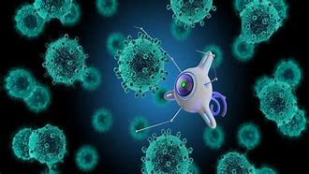
Wiggle, Wobble, Nanobot Challenge
NATURE SU2022
NDEPSCoR: NDSU/UND
Dr. Lori Gourneau

Slide 2
Session Organization: Today’s Schedule
10:30-10:45 Cultural Connection: Native American Inventions: Medicine & Camouflage. Video: 8 Incredible Inventions of the Indigenous Peoples of the Americas. Video Time: Medicine (start 3:25-5:30 stop)
10:45-11:30 Wiggle, Wobble, Nanobot Power Point Presentation.
11:30-12:00 Activity 1 Nanomedicine Explorer, a virtual exhibit.
12:00-12:30 Lunch
12:30-1:15 Activity 2 Wigglebot
1:15-2:00 Activity 3 Wobblebot
2:00-2:30 Activity 4 Bristlebot
2:30-2:45 Activity 5 Nanobot Challenge
2:45-3:00 Wrap-Up & Questions

Slide 3
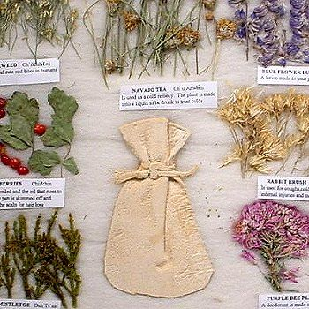
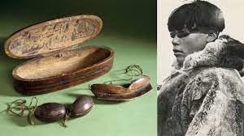
Cultural Connection: Native American Contributions to Technology.
Historically, indigenous tribal nations have contributed technology.
Food: corn, beans, squash, pumpkins, sunflowers, wild rice, sweet potatoes, tomatoes, peppers, peanuts, avocados, papayas, potatoes and cacao
Rubber
Kayaks
Snow Goggles
Baby Bottles
Medicine: Anesthetics and
Topical Pain Relievers
Syringes
Hammocks
Mouthwash
Raised-Bed Agriculture
Cable Suspension Bridges

Slide 4
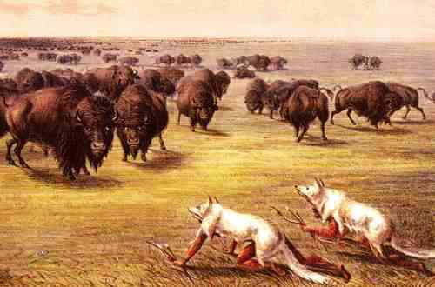
Cultural Connection: Native American Contributions to Technology.
Many inventions are still used today in America and throughout the world. In fact, it is reported that the indigenous people of North America were the first true inventors of camouflage.
Camouflage
Indigenous peoples of North America made many contributions to technology that we use today. The Ojibway & Dakota Nations along with many other tribal nations lived off the land by hunting and gathering food.
One of the main sources of food for the plains Indians was buffalo. In order to kill buffalo, the hunters had to master the art of camouflage in order to get close to their prey.
This skill gave the hunters an advantage allowing them to get close to the buffalo without being seen. Two ways that they did was through painting themselves and their clothing that would mimic their surroundings. Other ways of hiding themselves was to cover with blankets and hides. Native Americans were masters at the art of camouflage.

Slide 5
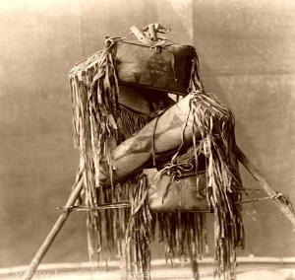
Cultural Connection: Native American Contributions to Technology.
Medicine
All Native American tribal nations utilized medicine to fight infections. Many tribes had medicine men or shamans who carried medicine bundles. A medicine bag or bundle is a bag that contained many medicinal items that were used to care for the tribal members.
The medicine bag was believed to protect or give spiritual power to the carrier. Some of the items that were contained in the bag or bundle includes herbs, seeds, bones, tobacco, grasses, horsehair or other items that the carrier thought to be of spiritual value. These bags were used for healing, protection and good luck for hunting etc.

Slide 6
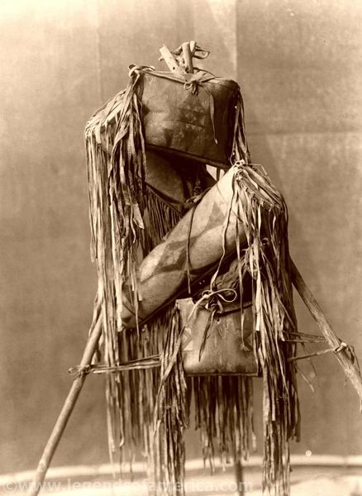
Cultural Connection: Native American Inventions: Medicine & Camouflage. Video Time: Medicine (start 3.25-5:30 stop) 8 INCREDIBLE INVENTIONS OF THE INDIGENOUS PEOPLES OF THE AMERICAS | History - Bing video

Slide 7
Nanotechnology: How Does It Apply to Medicine & Camouflage?
Nanotechnology manipulates material at the atomic and molecular scale and encompasses physics, chemistry, biology and technology to design, produce, synthesize materials to make them smaller, and stronger and better able to work in a variety of systems including the human body.
Nanotechnology has many applications in today’s society which include Nano-Medicine, Nanomaterials, Defense, Manufacturing, Spaceflight, Energy, and the Environment to name a few.

Slide 8
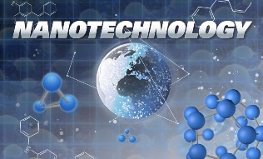
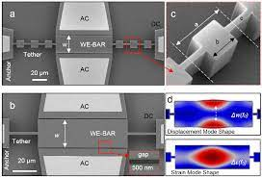
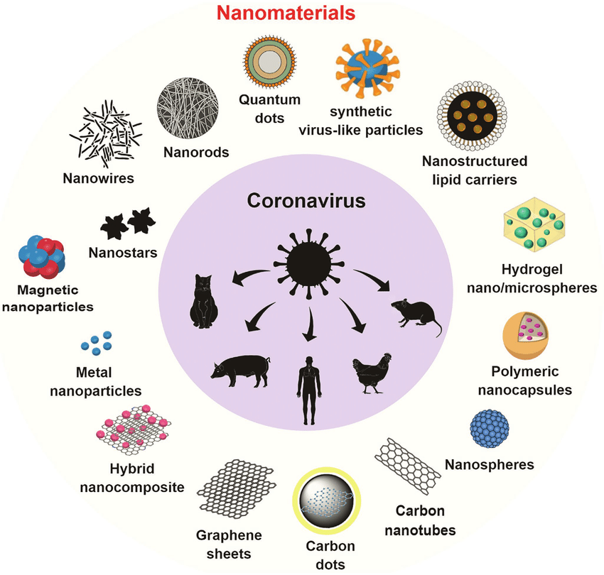
Nanotechnology
Nanotechnology | The usage of matter on the nanometer scale to produce structures, systems, and technological devices.
Nanoelectromechanical Systems (NEMS) | A generic term to describe nanoscale electrical/mechanical devices.
Nanomaterials | Nanoscale particles, films, and composites designed and assembled in controlled ways.

Slide 9
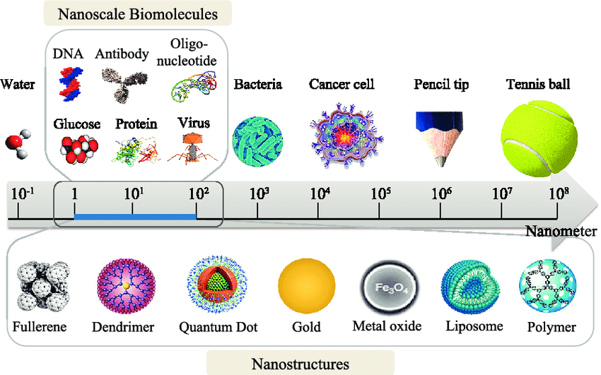
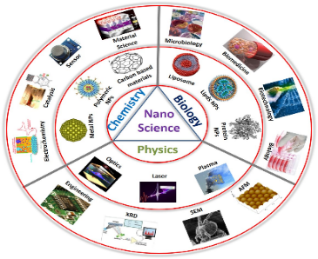
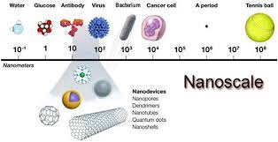
Nanotechnology
Nanoscale | Length scale applicable to nanotechnology (i.e., 1-100 nanometers).
Nanoscience | A nanoscale device capable of detecting stimuli at the molecular level.
Nanometer | one billionth of a meter or 1/1000 of a micrometer.
Nanometer | A unit of measurement equal to one-billionth of one meter. The head of a pin is about 1 million nanometers across. A human hair is about 60,000 nanometers in diameter, and a DNA molecule is between 2-12 nanometers wide.

Slide 10
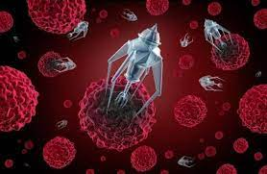
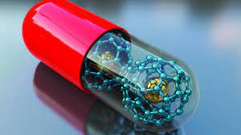
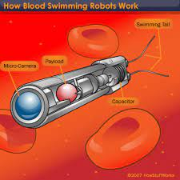
Nanotechnology
Nanomachine | A nanoscale device capable of performing mechanical movements due to responses to specific stimuli.
Nanomedicine | The application of nanotechnology to solve medical problems.
Nanobot | Robots that carry out a very specific function and are ~50–100 nm wide. They can be used very effectively for drug delivery. Normally, drugs work through the entire body before they reach the disease-affected area.

Slide 11
Nanotechnology: How Does It Apply to Medicine & Camouflage?
Nanomedicine is the application of nanotechnology to help solve medical issues.
Today, nanoscientists are using nanobots or robots which are about ~50–100 nm wide to carry out a very specific functions within the body. These nanobots can be used very effectively for drug delivery in the human body.
Normally, drugs work and travel through the entire body before they reach the disease-affected area. This new technology will allow scientists to directly attack tumors or specific diseased areas within the body.
The following slide is an excerpt from a video called “Welcome to the Era of Nanomedicine”.

Slide 12
Nanotechnology: How Does It Apply to Medicine & Camouflage?
Nanomedicine is the medical application of nanotechnology which uses biosensors, tissue engineering, and diagnostic devices to understand disease such as cancer. Scientist build nanoparticles that can conceal itself or evade itself from the surveillance of the human immune system. It camouflages itself in a way the body’s immune system does not attack it.
Nanoparticles go directly to the diseased tissue and this reduces the side effects of drugs. It also allows scientists to target the diseased tissue with a higher quantity of a drug via the nanoparticle. This treatment is being used today in clinical trials with cancer patients.
Nanobots were developed and used in the preclinical trials with animals. This allowed scientists to develop nanoparticles that can change to a fluorescent nanoparticle that lights up in diseased tissue and which can then return information from the nanoparticles to be analyzed by optics.
Micro robots have also been developed and they can travel through body fluids. The micro robots mimic human body tissues such as red blood cells. By taking the red blood cell membranes the robots camouflage themselves within the body and can circulate like the human red blood cell for about 120 days.
Show students this video on nanomedicine:
May 30 2013 YouTube: WSJ (Time 6:04) Welcome to the Era of Nanomedicine - Bing video

Slide 13
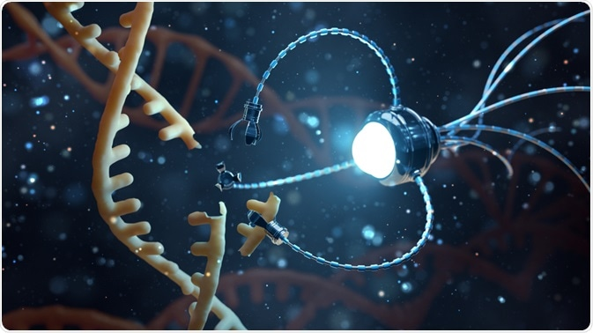
Activity 1 Nanomedicine Explorer, a virtual exhibit.
Learn more about nanotechnology & nanomedicine. Go to the link and show the students the following videos in order. These are very short videos, many less than a minute.
Home | Nanomedicine Explorer (nanomedicine-explorer.net)
**If you have time before lunch show “Stealth Imaging”.
What is nanotechnology
What is nanomedicine
What is cancer:
Overview
How do tumors form?
How does cancer spread?
Can nanotechnology help?
Battling cancer with nanotechnology:
Battling cancer
Early detection
Precise targeting
Zapping tumors with gold nanoshells
Overview
Inventing nanoshells
Fateful meeting
Supermarket chicken
Dramatic results
The personal side
If you were a patient
Is it safe
Zap a tumor-try it (see if it works on your computer).

Slide 14
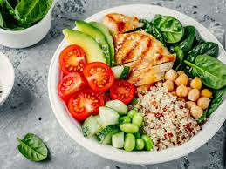
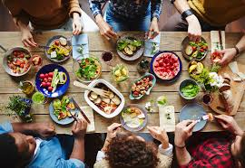
LUNCH TIME

Slide 15
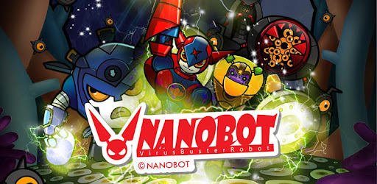
Activity Time
Activity 2
Wigglebot
Activity 4
Bristlebot
Brushbot
Activity 3
Wobblebot
Activity 5
Nanobot Challenge

Slide 16
Wiggle, Wobble, Nanobot Challenge
Gamification: Game based learning creates fun. It helps information to stick. In this challenge you will be given three robots to build and a puzzle to complete.
Each room will have one puzzle to solve and one or two robots to build. Once you have completed the projects you may move onto the next room.
The materials for each robot will be in the room numbered for your group and your group will have one desk. Only use your supplies on your desk. If you need something please ask the instructor.
When the group has completed the project and puzzle task, bring them back to the main classroom and go onto your next room. If you are unable to figure out the puzzle, that’s okay. Just bring it back to the room when your robot is finished.
This challenge is based on engineering. So take your time and do your best but monitor your time. Work together as a team.
Instructors group the students by counting off by 1-4. Each group should have 4 students. Two can work on the puzzle and two can work on the robot.
Do not play with your nanobots or the batteries. You will need them for the challenge.

Slide 17
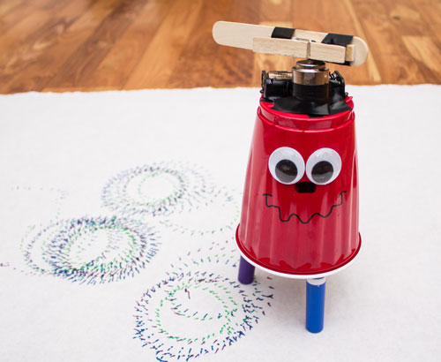
Activity 2: Wigglebot & Puzzle
Wigglebot Room: Find your desk with your team number. Puzzle: two students will work on the puzzle and two students will work on the wigglebot.
When you have completed both tasks, take your puzzle & wigglebot to your desk in the main room.
Go to the wobblebot room.

Slide 18
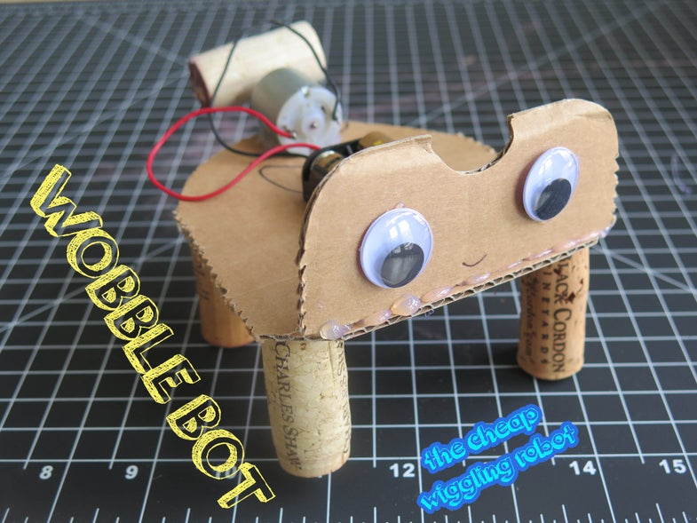
Activity 3: Wobblebot & Puzzle
Wobblebot Room: Find your desk with your team number. Puzzle: two students will work on the puzzle and two students will work on the wobblebot.
When you have completed both tasks, take your puzzle & wobblebot to your desk in the main room.
Go to the bristle/brushbot room.

Slide 19
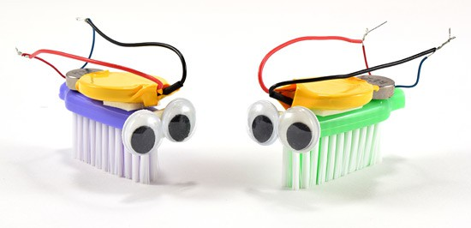
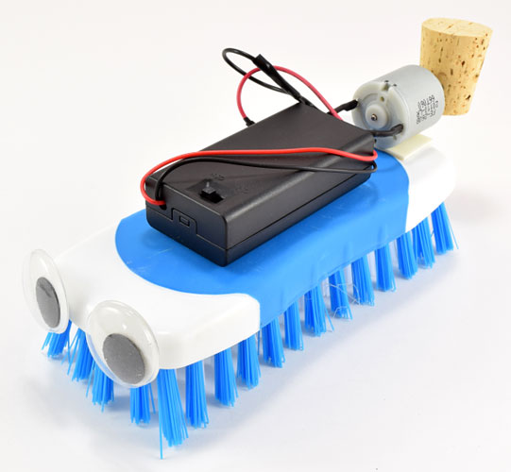
Activity 4: Bristlebot/Brushbot & Puzzle
Bristlebot/Brushbot Room: Find your desk with your team number. Puzzle: two students will work on the puzzle and two students will work on the bristlebot & brushbot.
When you have completed both tasks, take your puzzle & bristlebot & brushbot to your desk in the main room.
Go back to the main room and wait for the all of the teams to arrive.

Slide 20
Activity 5: Nanobot Challenge
Materials: Timer, & Masking Tape, tape a circle three feet in diameter on the floor. Fill out table as you go.
Challenge One: Each team will tape a sheet of paper on the floor inside the circle. How long does it take for the wigglebot to make two circles. Points by the fastest time for each team 5,4,3,2, 1 pts.
Challenge Two: How long does it take for your wobblebot, bristlebot and brushbot to leave the circle. Points by the fastest time for each team 5,4,3,2, 1 pts.
Nanobot | Team One | Team Two | Team Three | Team Four | Team Five
Wigglebot Time to make two circles
Wobblebot Time to exit circle
Bristlebot Time to exit circle
Brushbot Time to exit circle
Total Points

Slide 21
Activity 5: Nanobot Challenge
Challenge Three: Did your team complete the puzzles? Earn points even if you didn’t complete the task.
Nanobot Champs: the team with the most points.
Nanobot | Team One | Team Two | Team Three | Team Four | Team Five
Wobblebot Crossword Puzzle Completed (5pts), not completed (2pts)
Wobblebot Word Scramble Completed (3pts), not completed (1pt)
Maze Craze Completed (5pts), not completed (3 pts)
Brain Teasers: How many did you get correct. ( 1pt) for each correct answer.
Total Points

Slide 22
Wrap-Up
Take pictures of the Nanobot Champs
Take pictures of the Nanobots
Clean-Up
Questions???

Slide 23
Resources
(Unknown) 11 months ago. History 8 INCREDIBLE INVENTIONS OF THE INDIGENOUS PEOPLES OF THE AMERICAS | History Retrieved June 1, 2022 from 8 INCREDIBLE INVENTIONS OF THE INDIGENOUS PEOPLES OF THE AMERICAS | History - Bing video
Kiger, P. J. (Nov. 14, 2019). 10 Native American Inventions Commonly Used Today. History. Retrieved May, 24, 2021 from https://www.history.com/news/native-american-inventions
Coverdail, J. (2013). Native American Tools and Artwork. Youtube. Retrieved May 24, 2021 from https://www.youtube.com/watch?v=b94DeAWlT3A
(Unknown), (1998-2020). Dakota Indian Fact Sheet. North American Indian Tribes. Retrieved May 24, 2021 from http://www.bigorrin.org/dakota_kids.htm
“Nanotechnology: Basic Science and Emerging Technologies”, M. Wilson et al, Chapman and Hall (2002) ISBN 1-58488-339-1
(Unknown) Create Sliding Puzzle - Puzzel.org Sliding Puzzle Retrieved from 17 puzzle types to have fun with - Puzzel.org on May 30, 2022.

Slide 24
Resources
(Unknown). The Teacher’s Corner. Match-up Worksheet Maker. Retrieved from Match-up Worksheet Maker (theteacherscorner.net) on May 30, 2022.
(Unknown). (July 2, 2020) LockPaperEscape. Kids DIY Escape Room Ideas. YouTube. Retrieved from Kids DIY Escape Room Ideas | Make an escape room at home. - Bing video on May 30, 2022.
(Unknown). Northwestern International Institute for Nanotechnology. Glossary of Terms in Nanotechnology. Retrieved from Glossary of Terms in Nanotechnology - International Institute for Nanotechnology (iinano.org) on May 30, 2022.
(Unknown). UnderstandingNano. An Introduction to Nanotechnology. Retrieved from Nanotechnology Introduction (understandingnano.com) on May 30, 2022.
Finio, B. (Unknown) Build a Bristlebot, a Tiny Toothbrush Robot. Science Buddies. Retrieved on June 1, 2022 from Build a Bristlebot, a Tiny Toothbrush Robot | STEM Activity (sciencebuddies.org)

Slide 25
Resources
Finio, B. (Unknown) Build a Brushbot. Science Buddies. Retrieved on June 1, 2022 from Build a Brushbot | STEM Activity (sciencebuddies.org)
(Unknown). Instructables Workshop: Wobble Bot by Oakland Toy Lab. Retrieved on June 1, 2022 from Wobble Bot! : 5 Steps - Instructables
(Unknown). Nano Werk: What are nanobots? Retrieved on June 1, 2022 from What are nanobots? Explaining nanorobotics and nanorobots (nanowerk.com)
Marcus, A., Segal, H. (2018). Technology in America: A Brief History. Retrieved June 1, 2022 from Technology in America: A Brief History - Alan I Marcus - Google Books
Michelle, (July 6, 2015). Homemade Wigglebot. Research Parent Educational Resources by a Research Scientist. Retrieved on June 1, 2022 from Homemade Wigglebot - ResearchParent.com

Slide 26
Resources
Weiser, K. (Sept. 2021). Medicine Bags or Bundles. Legends of America. Retrieved June 1, 2022 from Medicine Bags or Bundles – Legends of America
Robinson, T. (Unknown). Camouflage tricks that Kept The Native Americans Hidden. OffTheGridNews. Better Ideas For Off The Grid Living. Retrieved June 1, 2022 from Camouflage Tricks That Kept The Native Americans Hidden - Off The Grid News
Kiger,P. Nov. 18, 201910 Native American Inventions Commonly Used Today. History. Retrieved on June 1, 2022 from 10 Native American Inventions - HISTORY
(Unknown) (May 30 2013) Welcome to the Era of Nanomedicine. Wall Street Journal. Retrieved on June 1, 2022 from YouTube Welcome to the Era of Nanomedicine - Bing video
(Unknown). (2008-2013). Nanomedicine Explorer, a virtual exhibit. National Science Museum Retrieved on June 1, 2022 from Is it Safe? | Nanomedicine Explorer (nanomedicine-explorer.net)

