Slide 1
NATURE Sunday Academy: Polymer Synthesis from Common Materials
Alexander Parent
North Dakota State University

Slide 2
Overview
Cultural Connection
What Are Chemical Bonds?
What Are Polymers?
Activity 1: Crosslinking Molecules To Make Plastics
Lunch
How Does Crosslinking Affect The Stability Of A Molecule?
Activity 2: Extracting Polymer Strands From Soda Bottles
Notes:
Overview of days activities. One activity in class before lunch, two lab activities after lunch.

Slide 3
What are polymers?
Polymer: A chemical made from small, repeating units.
Plastic: A polymer that can be molded or shaped using heat and/or pressure.
Polymers
Plastics
http://nptel.ac.in/courses/104103071/39 (accessed on 12-June-2016)
Notes:
Polymers are any molecule made from smaller, constituent molecules. Many natural polymers, DNA, proteins, etc. Plastics are polymers that can be molded or shaped w/ heat and/or pressure. Rubbers are natural plastics. Will model several natural polymers using model kits before lunch, then synthesize them in the lab after lunch.

Slide 4
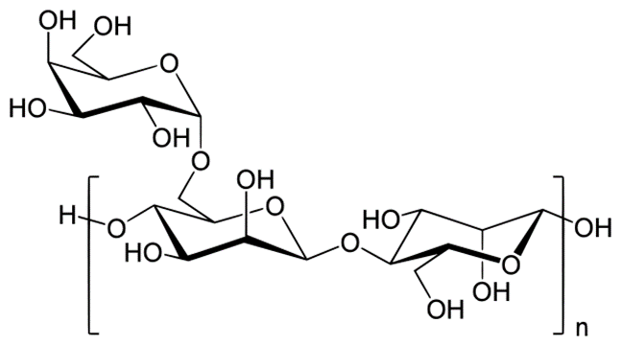
Natural Polymers
Amylose
Guar Gum
Polyalanine
Notes:
Amylose will be used to model Guar gum (polysaccharide from beans) that will be crosslinked in the afternoon. Polyalanine will be used to model the casein that will be concatenated in the afternoon.

Slide 5
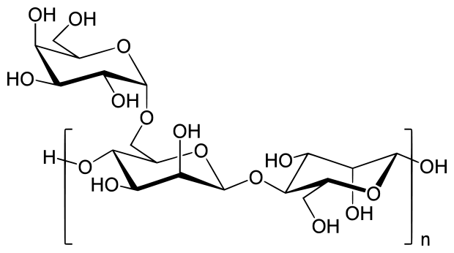
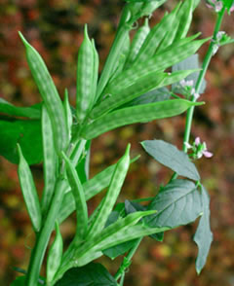
Guar Gum and Casein: Natural Polymers
Casein is a protein found in milk that complexes calcium.
Guar Gum is a polymeric sugar extracted from Guar beans.
We will concatenate (tie into knots) casein and covalently crosslink guar gum to form plastics.
Guar Gum
Casein
Notes:
Note no chemical bonds will form between casein molecules, they will only be held together by H-bonds and sterics.

Slide 6
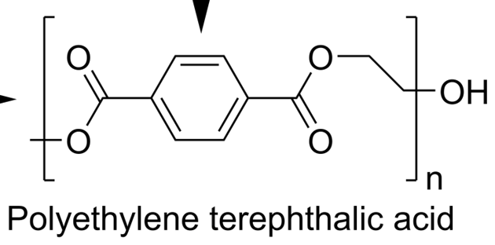
Guar Gum and Casein: Natural Polymers
Predict which plastic, concatenated casein or crosslinked guar gum, will be a stronger material. Write your prediction on your worksheet.
Predict which material will be softer (squishier).
Predict which material will be more durable.
Do you predict natural polymers to have better or worse properties than PET?
Guar Gum
Casein
Notes:
The polymerized guar gum actually ends up softer because it has more strength, the casein plastic crumbles when force is applied to it.

Slide 7
Activity 1: Crosslinking: Polymers to Plastics
You will need:
Safety Glasses
Gloves
100 mL Guar Gum Solution
0.5 mL Borax Solution
100 mL of Skim Milk
50 mL of Vinegar
3 Large Beakers (~200 mL)
2 Graduated Cylinders
1 Metal Pan
1 Small Beaker (~10 mL)
2 Stir Rods
1 Hot Plate
1 Stopwatch
Put on safety glasses and gloves.
Cover your metal pan with metal foil.
Place your metal pan on your hotplate.
Add 100 mL of skim milk to a large beaker.
Place the beaker in the metal pan, add water to the pan.
Set the hotplate on high, and continuously stir.
When milk begins to simmer, lower heat to medium-high.
While stirring, add 10 mL of vinegar to the milk.
After one minute, add another 10 mL of vinegar.
After no more changes are observed, turn off the hotplate and allow the solution to cool.
Add 100 mL of Guar Gum solution to a beaker.
While stirring, add 0.5 mL of borax to the guar gum.
Record your observations.
Notes:
Emphasize the borax needs to be added slowly while stirring, otherwise all of the crosslinks will form in the same region of the solution and you won’t get the desired gooeyness.

Slide 8
Lunch Break

Slide 9
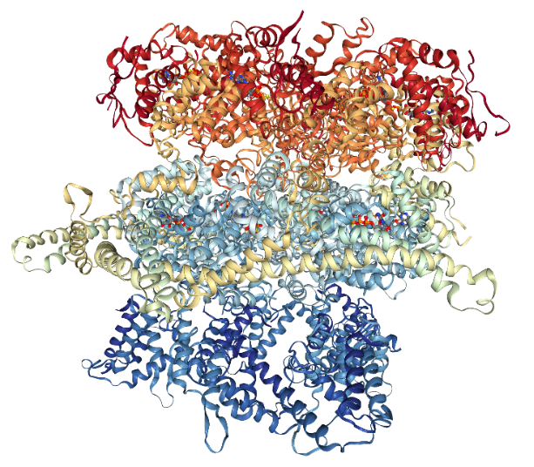
Activity 1 Discussion
What were some of the properties of your casein and guar gum polymers?
Is there a relation between the structures of the molecules and these properties?
What properties of polymers make them useful?
Cross-linked Guar Gum
Casein
Notes:
The guar gum plastic will be stronger, some reasons students might give include molecular linkages in the guar gum, or more connections in the guar gum. The plastics are similar to PET in that they can change shape when heat is applied. Unlike the PET, they cannot be reshaped if reheated (thermoset), while the PET can be reshaped if heat is applied (thermoplastic). At higher T the individual strands of PET in the bottle begin to separate from one another, allowing it to be reformed.

Slide 10
Activity 2: Extracting Polymer Strands From Soda Bottles
Put on safety glasses and gloves.
Place your piece of foil on the hotplate.
Place the piece of PET on top of the foil, make sure the PET does not touch the hotplate!
Set the hotplate on high.
When the PET starts to melt, remove the foil from the hotplate.
Lift the PET off the foil using your tweezers.
Use your tweezers to pull fibers out of the plastic!
Allow the plastic to cool.
Try to stretch and bend the cooled strands.
You will need:
Safety glasses
Gloves
1 Hot Plate
1 Piece of PET
1 Piece of Foil
1 Pair of Tweezers or Forceps

Slide 11
Activity 2 Discussion
In what ways is PET similar to the polymers you made?
How did the properties of PET change when it was heated?
Why do you think the properties of the PET changed in this way?
What might happen if you heated the polymers you made?
Notes:
The guar gum plastic will be stronger, some reasons students might give include molecular linkages in the guar gum, or more connections in the guar gum. The plastics are similar to PET in that they can change shape when heat is applied. Unlike the PET, they cannot be reshaped if reheated (thermoset), while the PET can be reshaped if heat is applied (thermoplastic). At higher T the individual strands of PET in the bottle begin to separate from one another, allowing it to be reformed.

